Slide 1
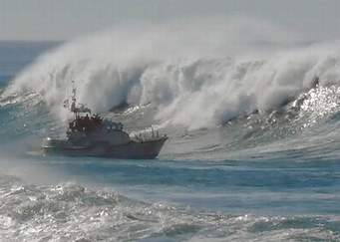
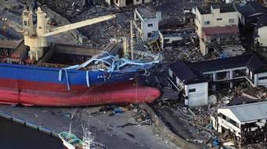
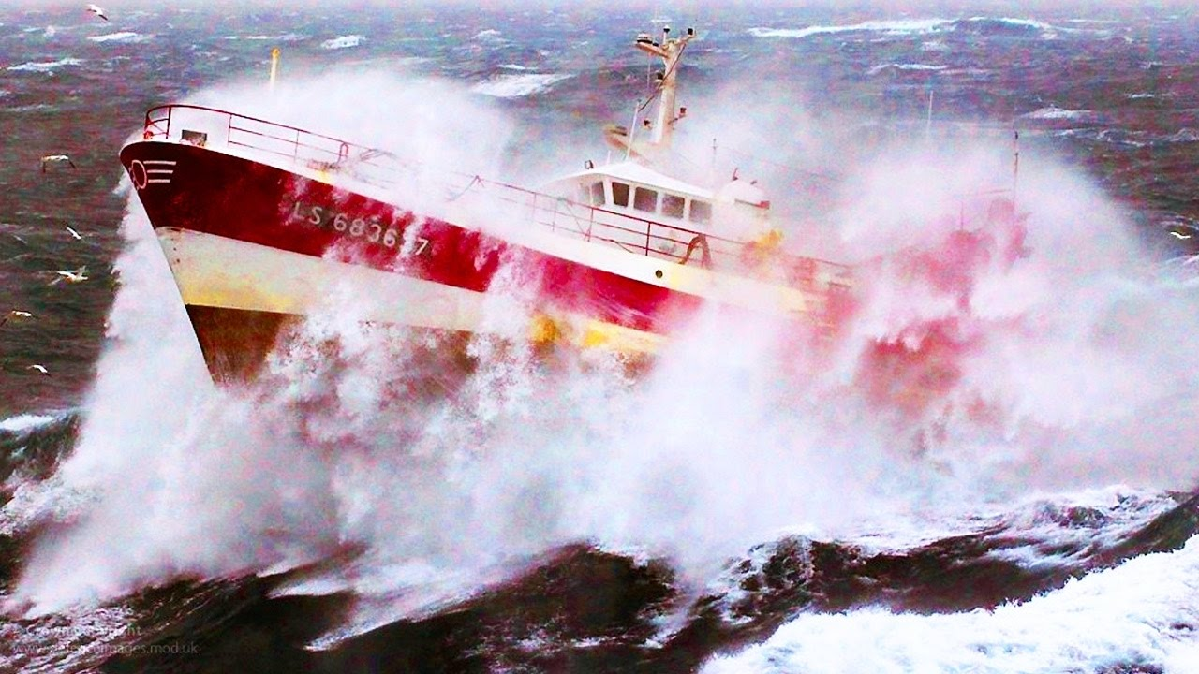
Tropical Analysis and Forecast Branch
Marine Forecasts
To provide meteorological analysis, forecasts and warnings over the tropical and subtropical oceans for the protection of life and property

Slide 2
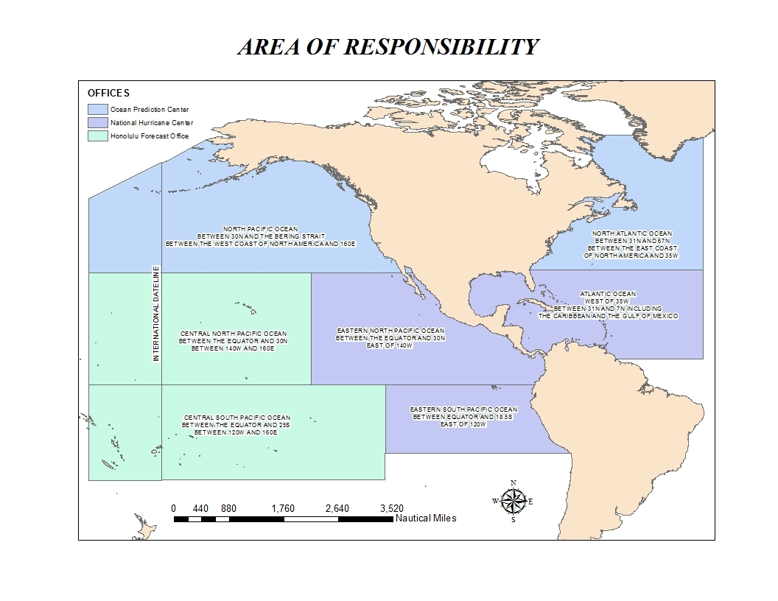
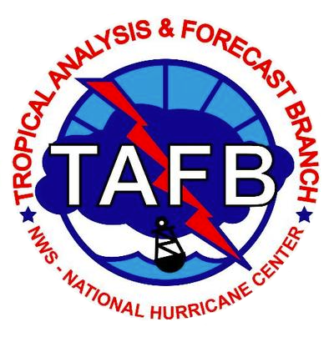
NHC/Tropical Analysis and Forecast Branch - Areas of Responsibility
Ocean
Prediction
Center
Ocean Prediction Center
NHC / TAFB
Honolulu Forecast
Office

Slide 3
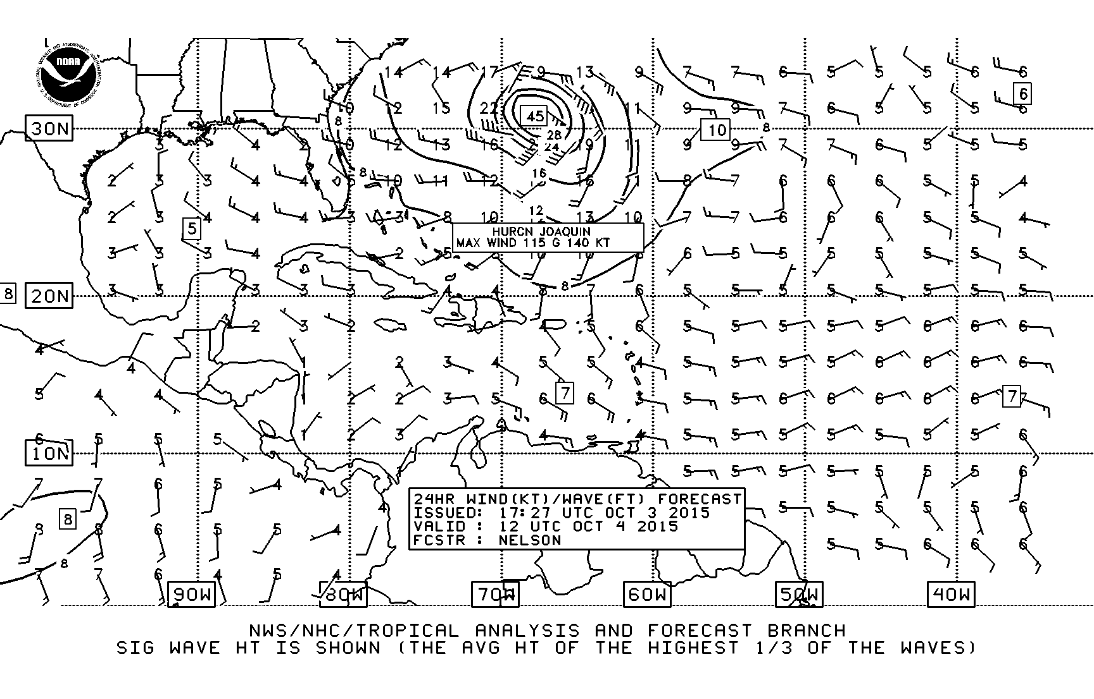
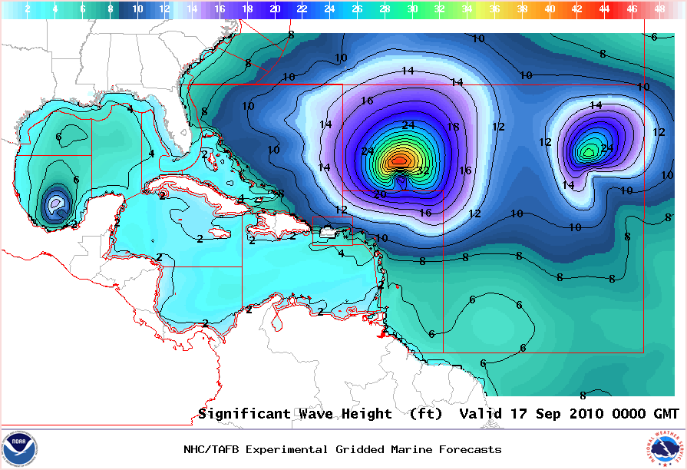
NHC/TAFB Marine Forecast Products
High Seas and Offshores Text Forecasts
HIGH SEAS FORECAST
NWS NATIONAL HURRICANE CENTER
1030 UTC FRI OCT 02 2015
SUPERSEDED BY NEXT ISSUANCE IN 6 HOURS
SEAS GIVEN AS SIGNIFICANT WAVE HEIGHT...WHICH IS THE AVERAGE
HEIGHT OF THE HIGHEST 1/3 OF THE WAVES. INDIVIDUAL WAVES MAY BE
MORE THAN TWICE THE SIGNIFICANT WAVE HEIGHT.
PAN PAN
ATLANTIC FROM 07N TO 31N W OF 35W INCLUDING CARIBBEAN SEA AND
GULF OF MEXICO.
SYNOPSIS VALID 0600 UTC FRI OCT 02.
24 HOUR FORECAST VALID 0600 UTC SAT OCT 03.
48 HOUR FORECAST VALID 0600 UTC SUN OCT 04.
.WARNINGS.
...HURRICANE WARNING...
.HURRICANE JOAQUIN NEAR 23.3N 74.7W 935 MB AT 0900 UTC OCT 02
MOVING NW OR 315 DEG AT 3 KT. MAXIMUM SUSTAINED WINDS 115 KT
GUSTS 140 KT. TROPICAL STORM FORCE WINDS WITHIN 160 NM W
SEMICIRCLE...140 NM NE QUADRANT AND 180 NM SE QUADRANT. SEAS 12
FT OR GREATER WITHIN 400 NM NE QUADRANT...150 NM SE
QUADRANT...120 NM SW QUADRANT...AND 300 NM NW QUADRANT WITH SEAS
TO 39 FT. ELSEWHERE S OF 28N BETWEEN 70W AND 78W WINDS 20 TO 33
KT. SEAS 9 TO 12 FT. N OF 28N BETWEEN 70W AND 75W E WINDS 20 TO
25 KT SEAS 8 TO 10 FT. REMAINDER OF AREA N OF 21N BETWEEN 65W
AND 78W AND OUTSIDE OF THE BAHAMAS WINDS 20 KT OR LESS. SEAS 8
TO 11 FT IN MIXED SWELL.
Wind Wave
Grids

Slide 4
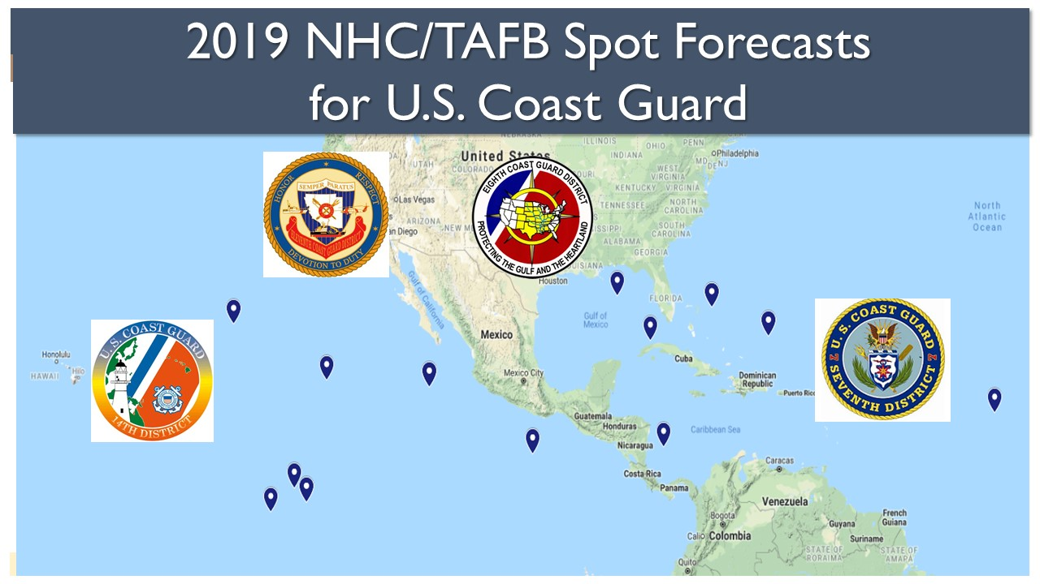
54 Spot Forecasts by NHC/TAFB
for 2019 U.S. Coast Guard District Operations

Slide 5
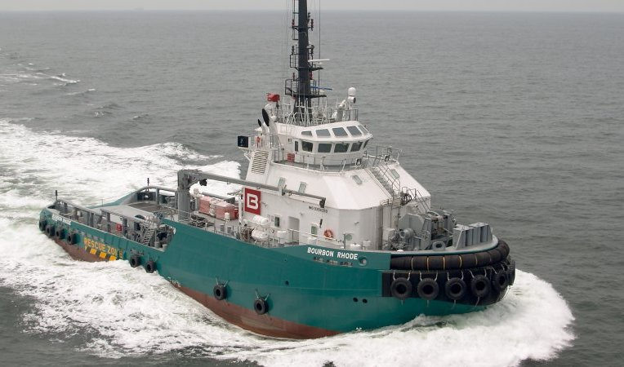
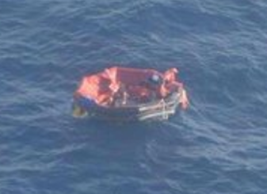
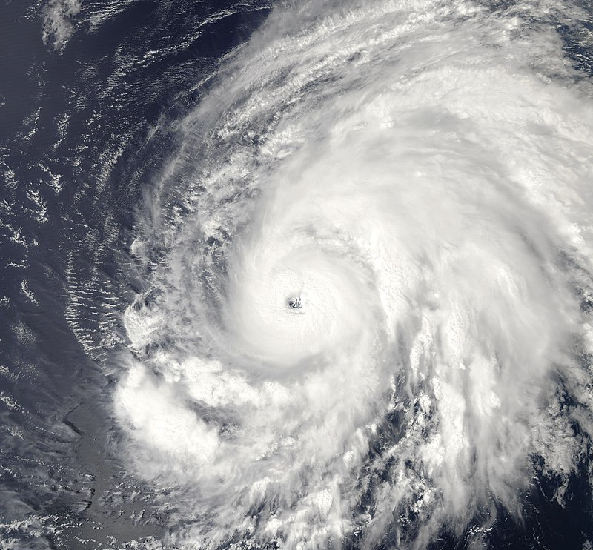
Impact-based Decision Support Services
Bourbon Rhode Sinks in Hurricane Lorenzo: September 26 – October 5, 2019
Bourbon Rhode Sinks in Atlantic Ocean; Three Rescued
Offshore tug sank in Hurricane Lorenzo
NOAA Hurricane Hunter aircraft supported U.S. Coast Guard and French Navy’s Search and Rescue efforts
35 marine spot forecasts provided by TAFB
Three mariners rescued from life raft in central Atlantic Ocean
Photo courtesy: Marine Nationale
via gCaptain

Slide 6
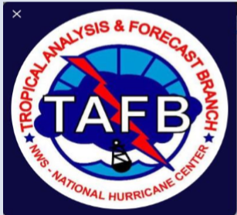
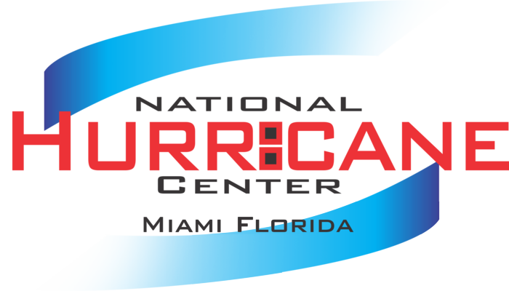
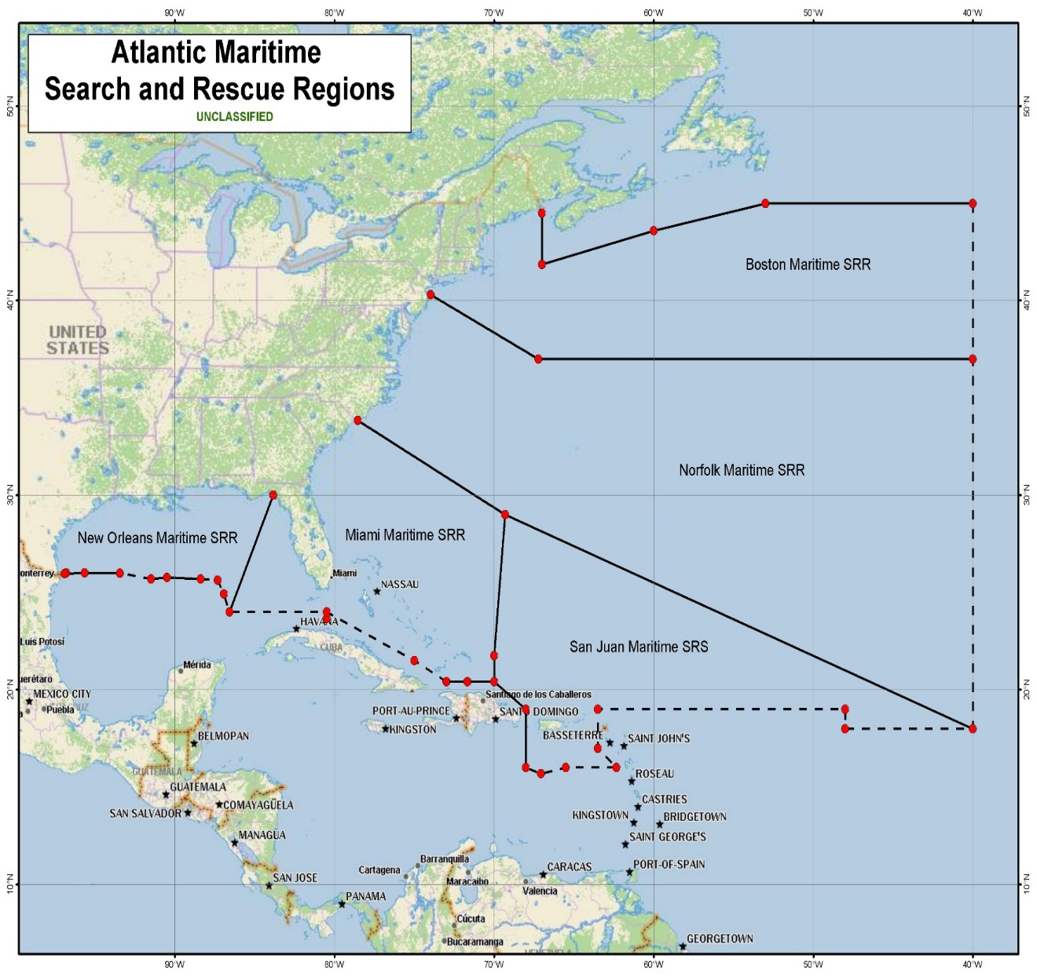
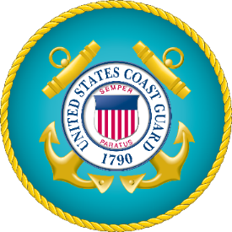
Decision Support Services to U.S. Coast Guard Districts by Tropical Analysis and Forecast Branch (TAFB)/ National Hurricane Center (NHC)
D7/Miami:
Hurricane Dorian (22 briefings)
Hurricane Humberto (5 briefings)
Hurricane Jerry (2 briefings)
Trop. Storm Karen (2 briefings)
Trop. Storm Nestor (4 briefings)
D8/New Orleans:
Hurricane Dorian (3 briefings)
Trop. Storm Nestor (2 briefings)
Trop. Storm Olga (2 briefings)

Slide 7
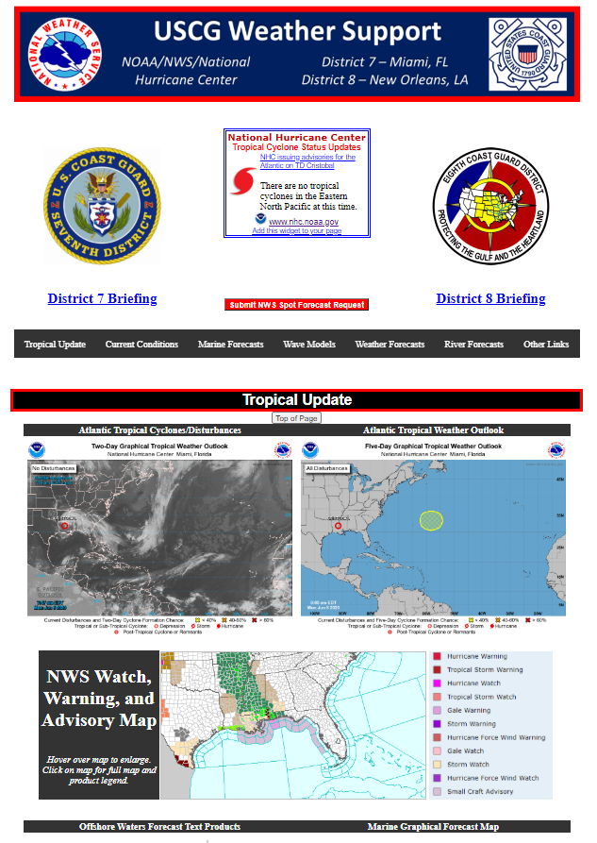
USCG Weather Support Webpage
https://www.nhc.noaa.gov/uscg/
National Hurricane Center Tropical Cyclone Status Updates
Latest Hurricane Briefings Available to Download
(in development)
Submit National Weather Service Spot Forecast Request

Slide 8
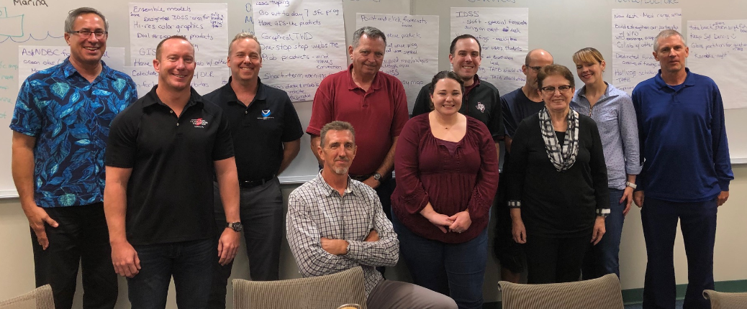
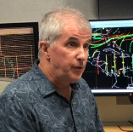
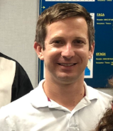
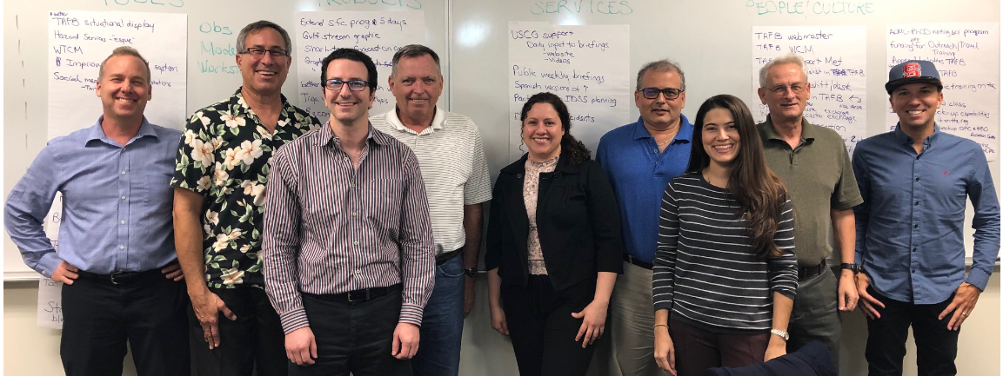

Slide 9
National Hurricane Center/
Tropical Analysis and Forecast Branch
https://www.nhc.noaa.gov/marine/?atlc
1-305-229-4424 – Atlantic/Gulf/Caribbean
1-305-229-4425 – Pacific
On Facebook: NHC TAFB | On Twitter: @NHC_TAFB

Slide 10
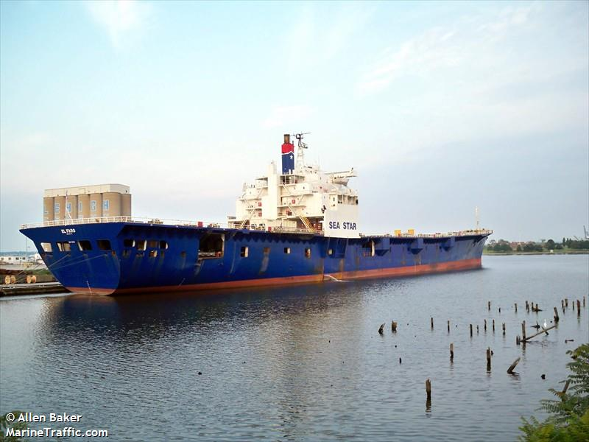
EL FARO
33 fatalities when it sank in Hurricane Joaquin (2015)
BOURBON RHODE
11 fatalities when it sank in Hurricane Lorenzo (2019)
BOUNTY
2 fatalities when it sank in Hurricane Sandy (2012)
FANTOME
31 fatalities when it sank in Hurricane Mitch (1998)

Slide 11
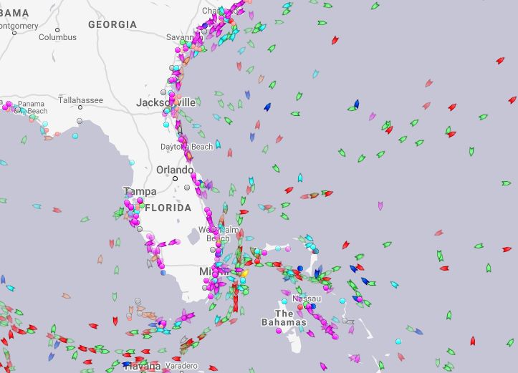
Ship Hurricane Avoidance for H Dorian

Slide 12
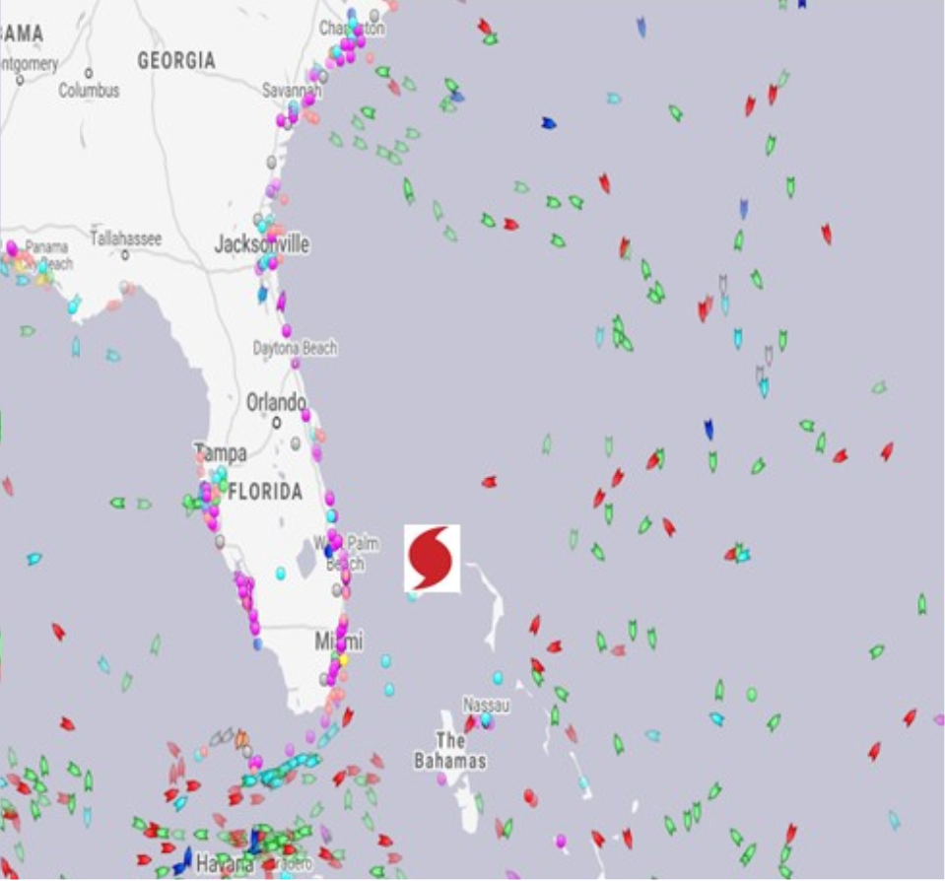
Ship Hurricane Avoidance for H Dorian
"I cannot overstate how much your [NHC/TAFB] insight into the storm’s effects is vital to our planning and response efforts.”
CAPT Eric Smith
Chief, Incident Management Branch
CG District Seven

Slide 13
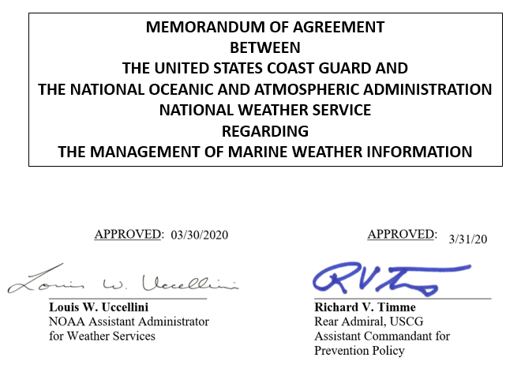
USCG/NWS Memorandum of Agreement
Interagency coordination to support our common goals
"THE USCG AGREES TO primarily use NOAA/NWS analysis and forecast products for USCG field unit decision making, such as weekly weather briefings and extraordinary events, such as hurricanes, winter storms, major oil spills, rescues, large-scale exercises, or other incidents of that caliber."
“NOAA/NWS agrees to provide USCG units with weather information necessary for the safe and successful accomplishment of their assigned missions.”
"USCG should support NOAA/NWS training efforts by, whenever possible, encouraging NOAA/NWS staff to accompany them on short at sea missions.“
"USCG should support NOAA/NWS training efforts by, whenever possible, encouraging NOAA/NWS staff to ...[conduct] visits to USCG coastal units." "Local NOAA/NWS offices should assist local USCG personnel through training efforts and encouraging visits to NOAA/NWS forecast offices."

