Slide 1
Online Weather Tools to Consider for USCG In-house Weather Briefings and Situation Awareness

Slide 2
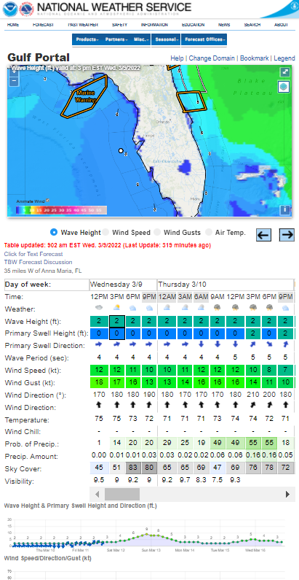
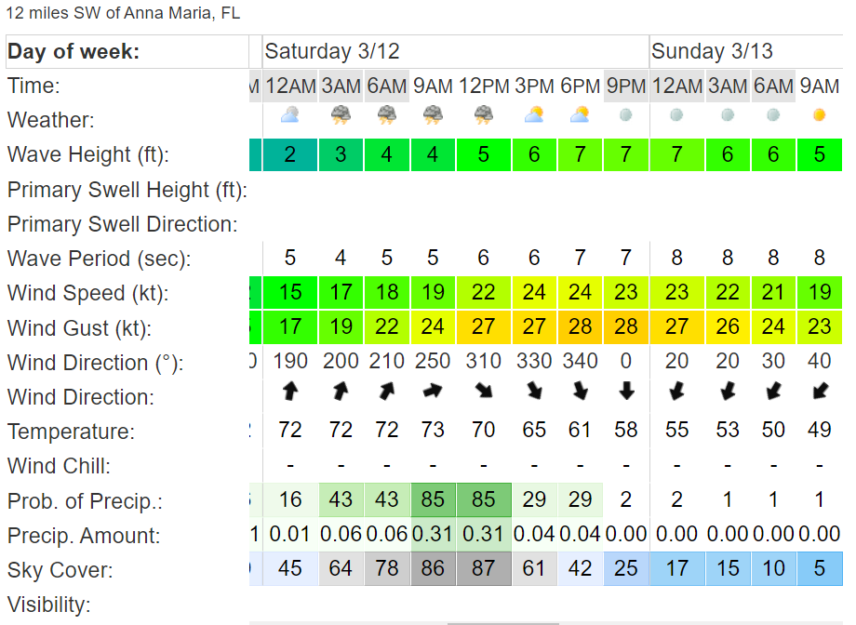
NWS 7-Day Marine Hourly Forecast
https://www.weather.gov/greatlakes/?portal=Gulf
Point-n-Click Forecast
Hourly Table
Forecast Graphs

Slide 3
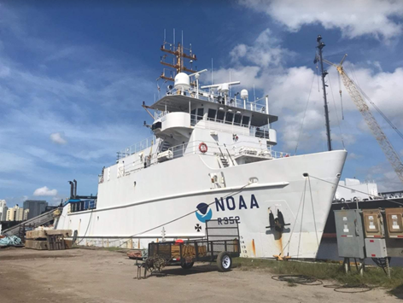
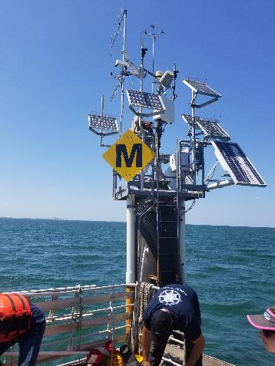
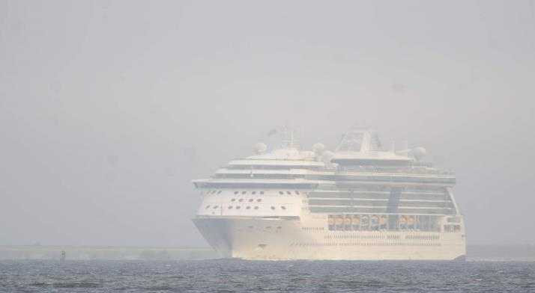
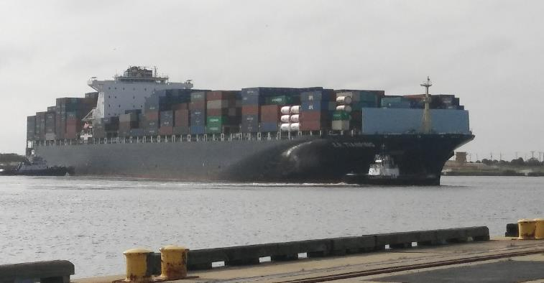
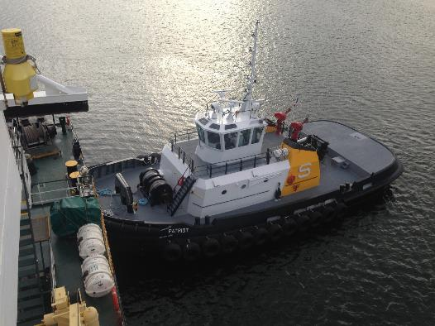
Tampa Bay Marine Channels Forecast
NOAA Collaboration between National Ocean Service (NOS) and National Weather Service (NWS)
Precision Navigation Decision Support Services:
Probability of Visibility < 1mile
Visibility Sensors: NOAA and University of South Florida
High and Low Water Level Forecast (NOS)
Wind, Weather, and Visibility Forecast (NWS)
Partner Experiences:
Sea Fog / Reduced Visibility in Tampa Bay
High and Low Water Levels

Slide 4
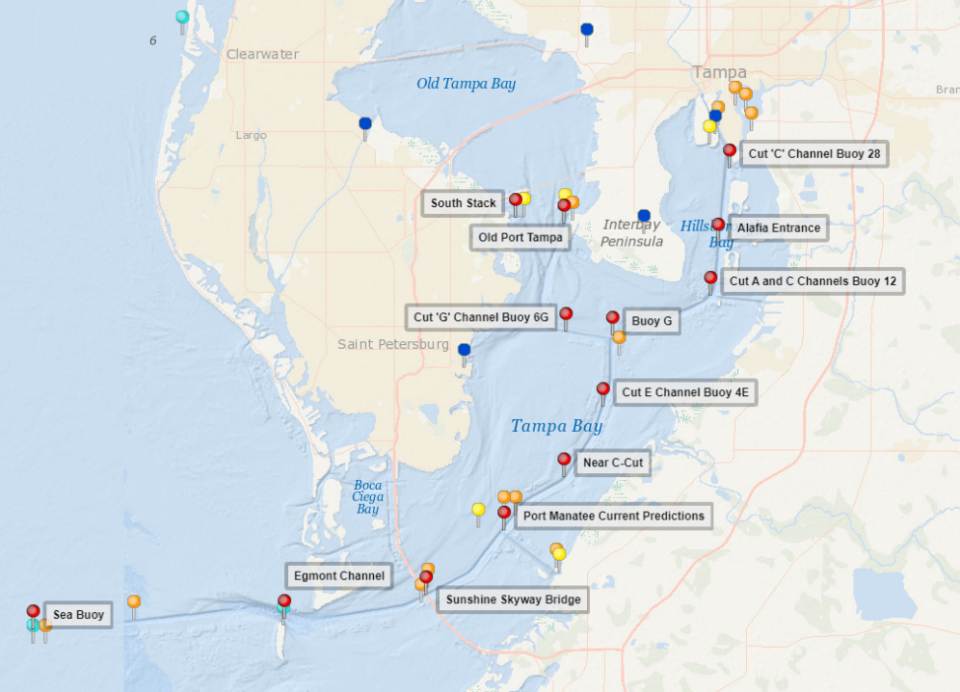
Developed Tampa Bay Marine Channels Forecast
Meteorological/oceanographic forecasts at 13 stations located along marine channels
NOAA Gulf of Mexico Regional Collaboration Team working to expand this to other areas. Mobile Bay has been completed, Texas is next
https://tidesandcurrents.noaa.gov/ofs/tbofs/tbofs_mcf.html
Notes:
Collaboration with NOS, Port Tampa, University of South Florida, and NWS Tampa Bay

Slide 5
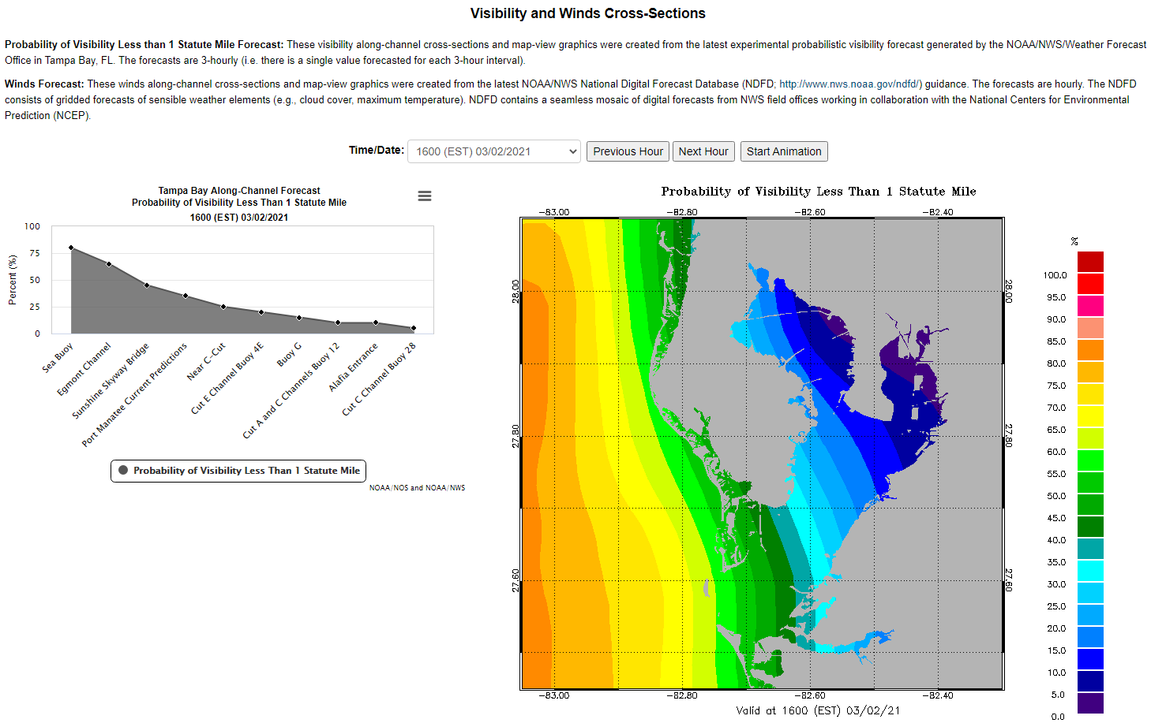
https://tidesandcurrents.noaa.gov/ofs/tbofs/tbofs_mcf.html

Slide 6
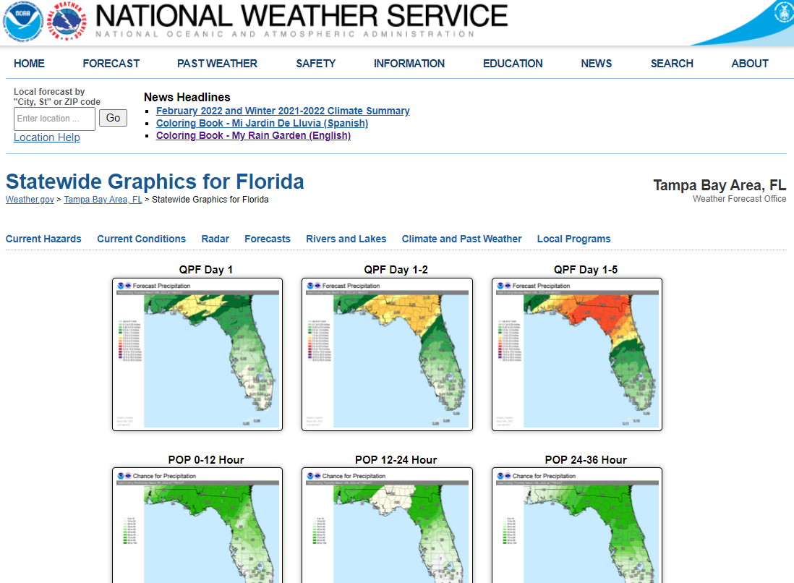
33 Statewide Graphics for Weather Briefings
https://www.weather.gov/tbw/florida

Slide 7
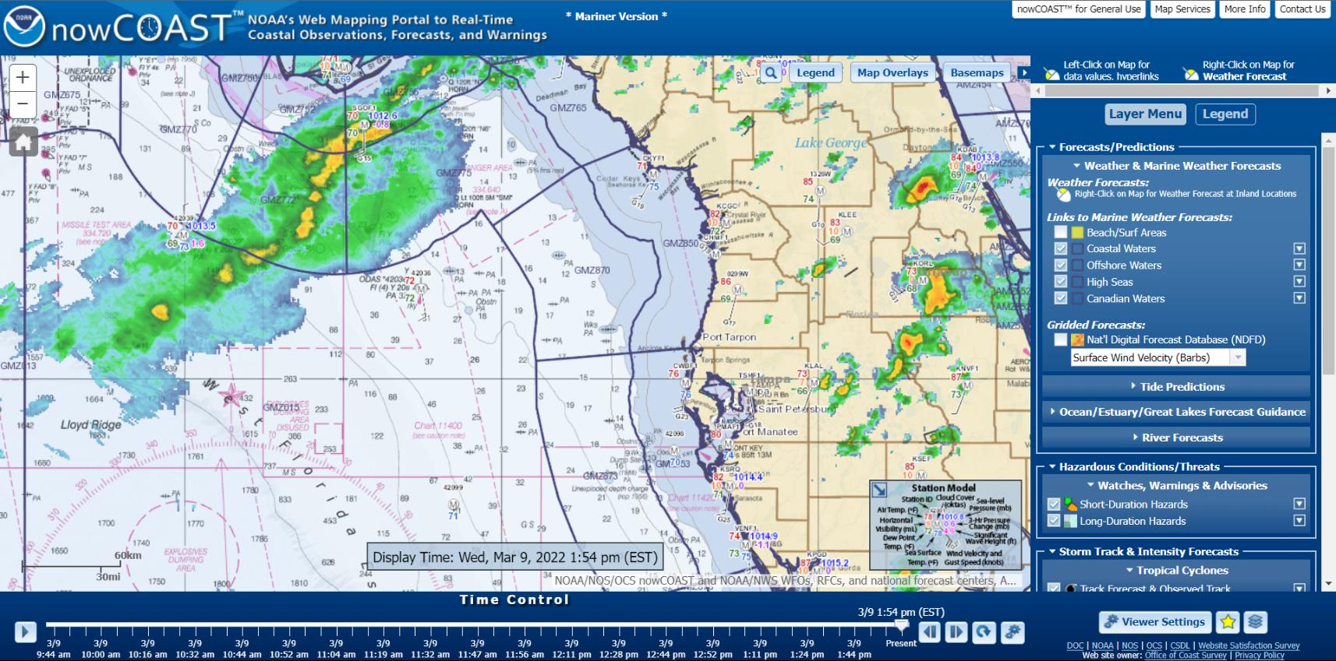
NOAA nowCOAST
https://nowcoast.noaa.gov/mariner.html

Slide 8
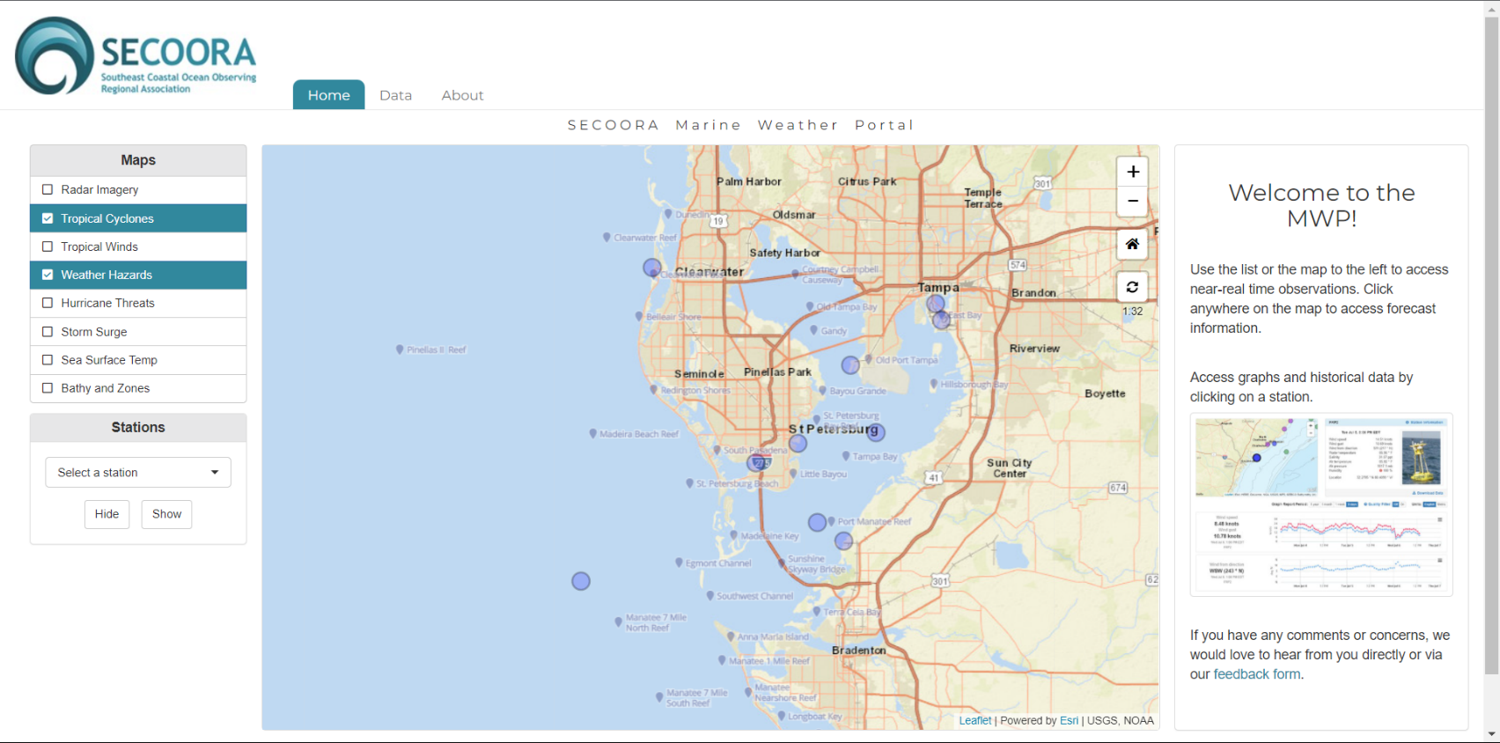
SECOORA Marine Weather Portal
https://mwp.secoora.org/

Slide 9
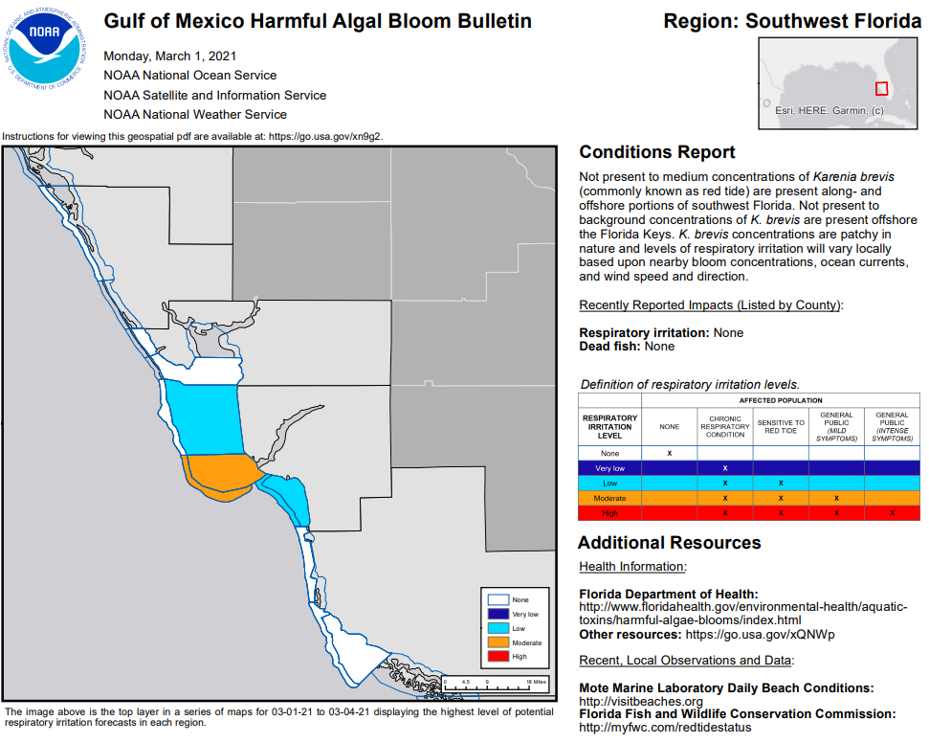
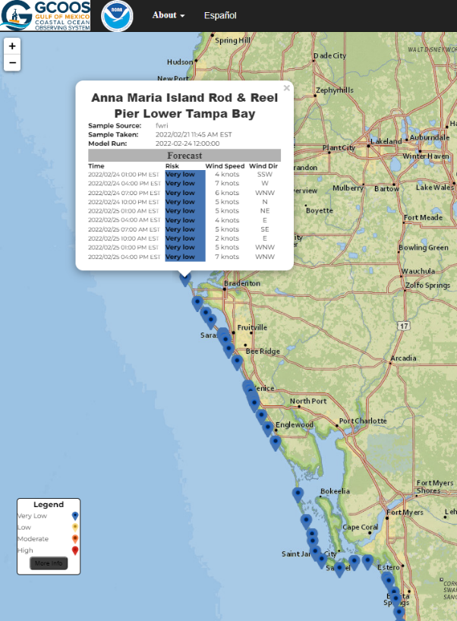
NOS, NSIS, NWS Harmful Algal Bloom Partnership
Notes:
https://habforecast.gcoos.org/

Slide 10
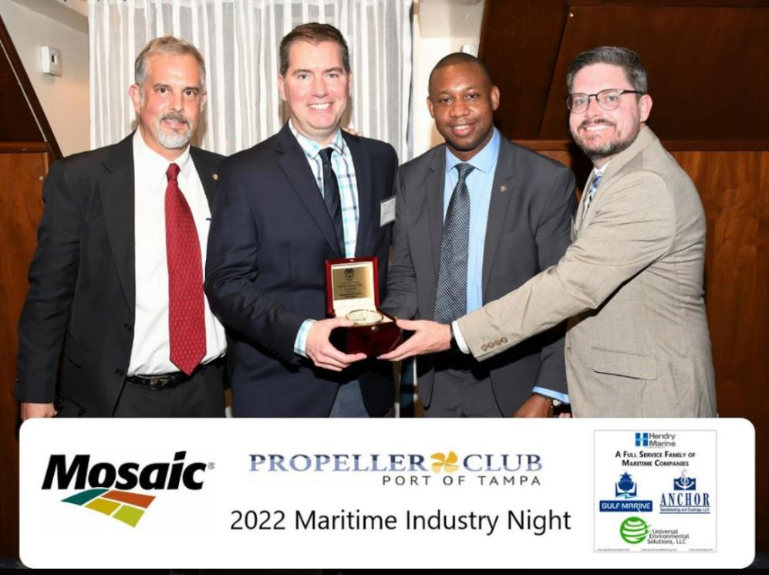
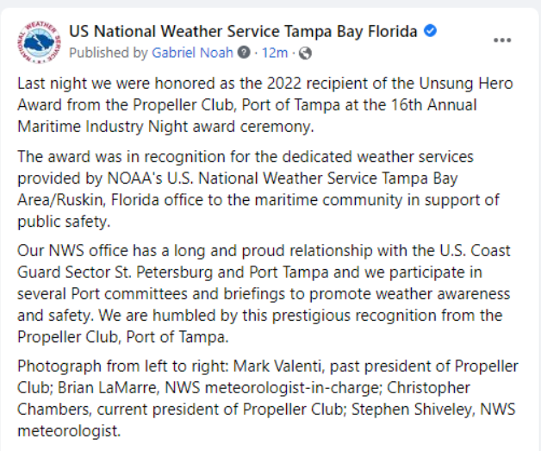
NWS Tampa Bay Received the Unsung Hero Award

Slide 11
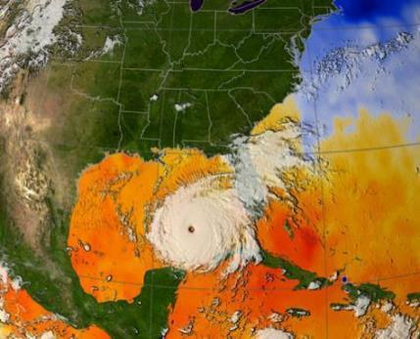
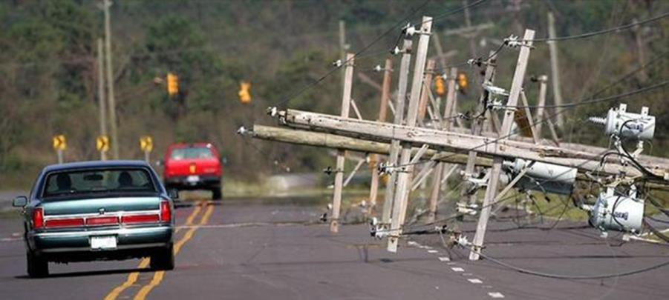
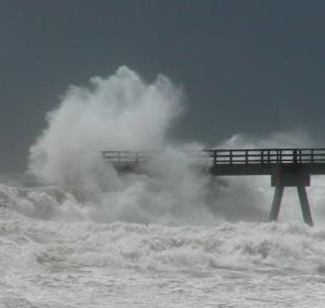
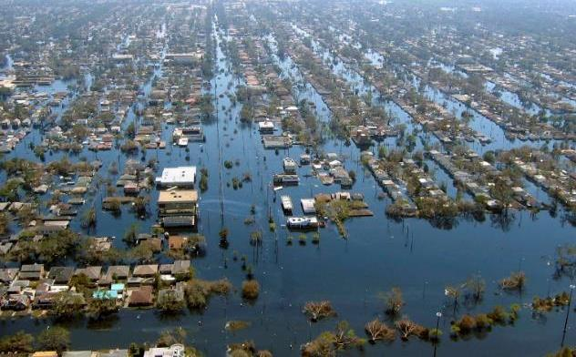
Questions or Comments?
https://weather.gov/tampa
https://radar.weather.gov
https://weather.gov/forecastpoints
https://weather.gov/wrn
https://weather.gov/stormready

