Slide 1
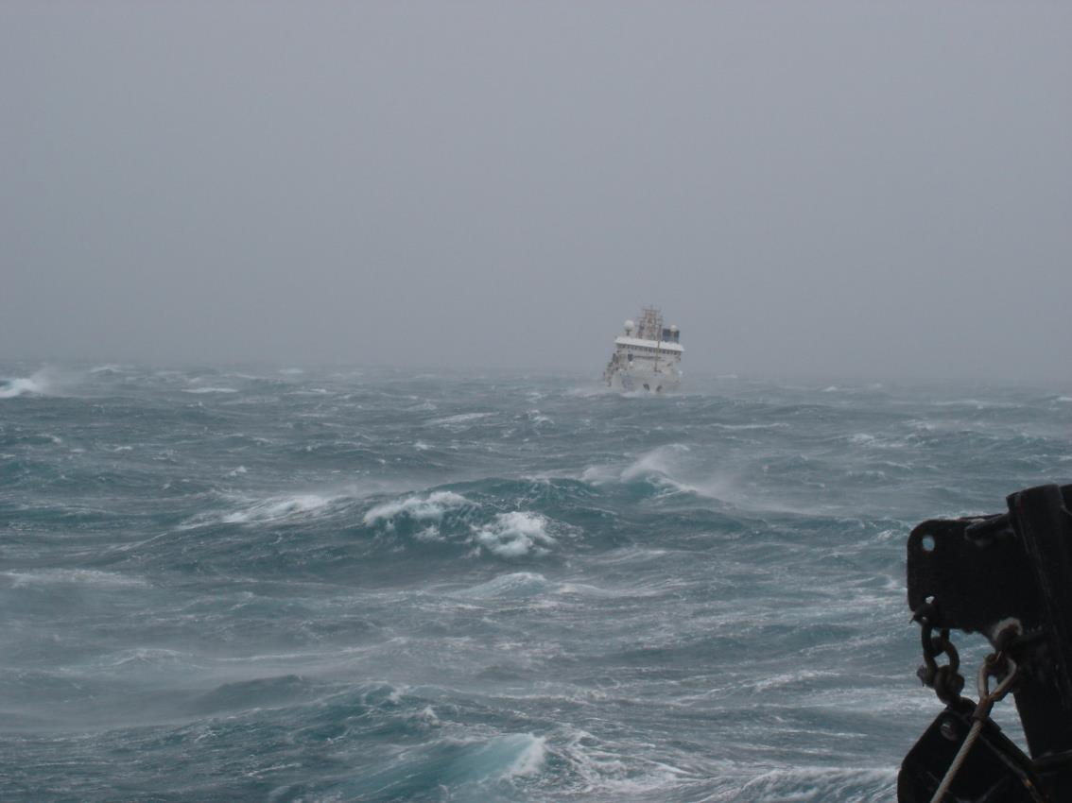
Local NWS Resources for the USCG
Daniel Noah Warning Coordination Meteorologist
National Weather Service – Tampa
daniel.noah@noaa.gov

Slide 2
We are a Federal Government Agency
Department of Commerce
National Oceanic and Atmospheric Administration (NOAA)
National Weather Service
Local Weather Forecast Office
National Hurricane Center
Storm Prediction Center
River Forecast Center
Environmental Modeling Center
Aviation Weather Center
Climate Prediction Center
Space Weather Prediction
Ocean Prediction Center

Slide 3
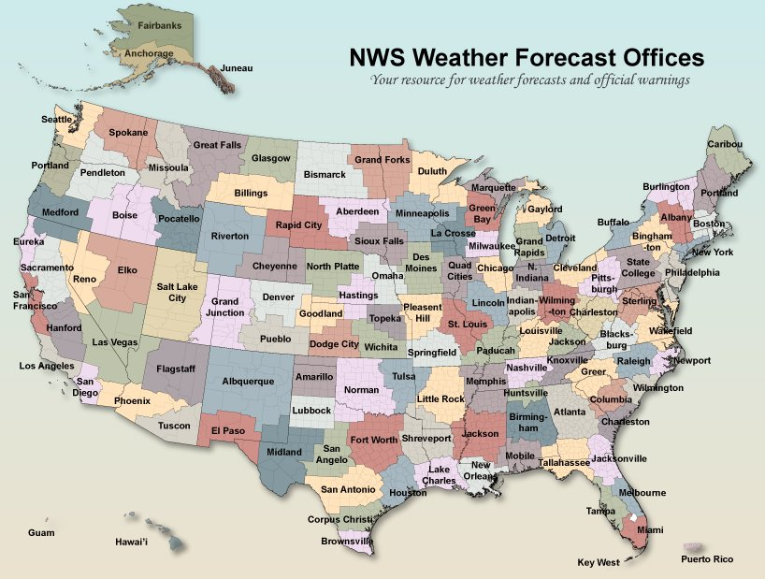
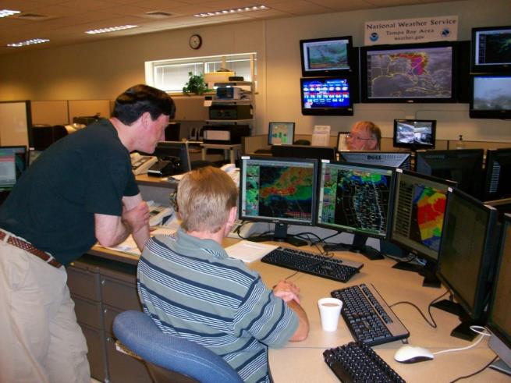
122 NWS Local Weather Forecast Offices
23 Employees
17 are Meteorologists
24 hours a day
365 days a year

Slide 4
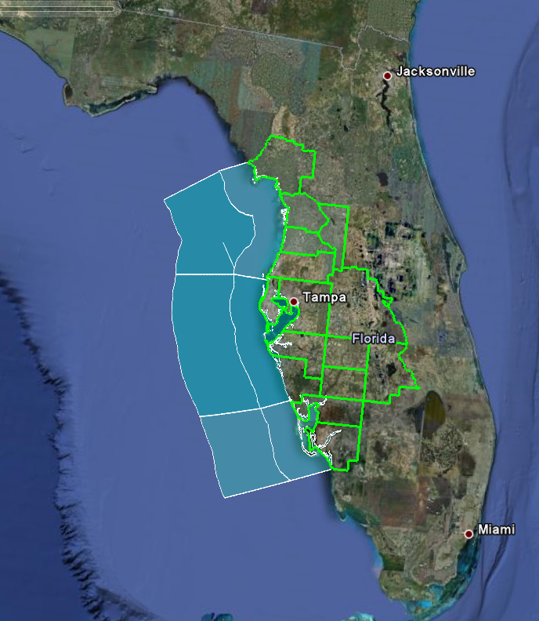
WFO Tampa Bay – Area of Responsibility
Office Statistics
15 counties
8 marine zones
55% of Florida’s hazardous material passes through the Port Tampa Bay
7 airport terminal forecasts
19 river forecast points
2020 Estimated Populations
WFO – 6.2 million
Florida – 21.5 million

Slide 5
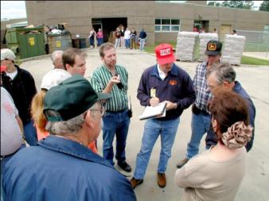
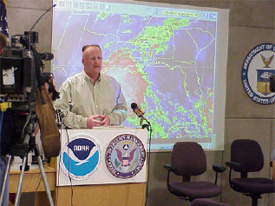
Members of the Integrated Warning Team
Emergency
Management
and Public
Officials
National Weather Service
America’s Weather and Climate Industry
(e.g. TV, Radio, Newspaper, Media, Private Companies, & App Developers)

Slide 6
Decision Support Services

Slide 7
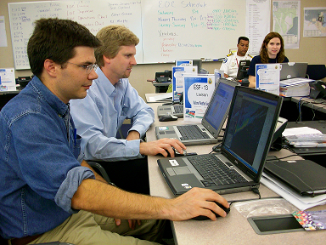
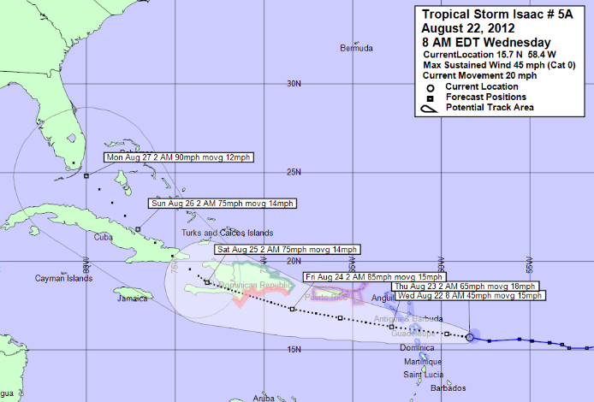
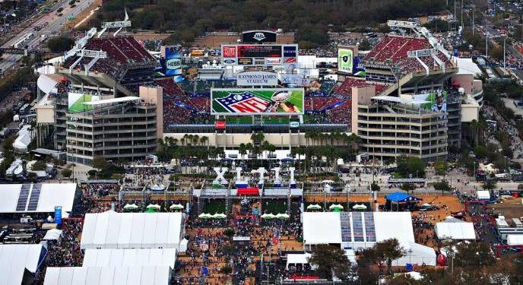
Key Partnerships – Decision Support in County EOCs
2009 & 2021 Super Bowls
2012 Republican National Convention
RNC Officials were debating to move the event to Atlanta, our forecast kept it in Tampa

Slide 8
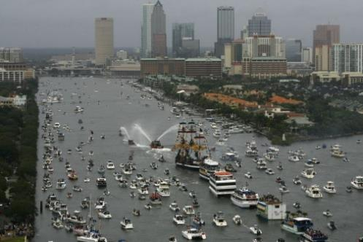
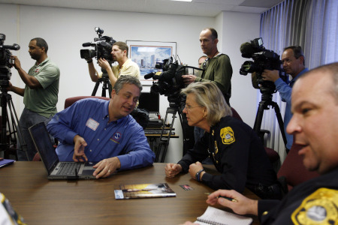
Key Partnerships – Decision Support in County EOCs
January 19, 2008 – Gasparilla Kids Parade cancelled mid-stream as severe weather approached
“Thanks to the Forecasters on duty Saturday, January 19th during the Kids Parade for Gasparilla - they worked very closely with us and were vital in making the decision to cancel the parade for the safety of the public - it was not a popular decision, but it was the right one!”
Larry Gispert, Director
Hillsborough County Emergency Management
2008 President, IAEM

Slide 9
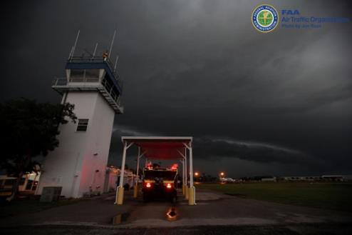
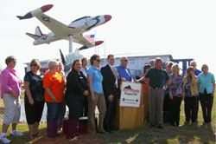
Key Partnerships – Decision Support in County EOCs
March 31, 2011 EF-1 Tornado Hits Sun n Fun Aerospace Expo (30-50K people each day of the 6 day event)
15 people injured
50 planes reported as damaged or destroyed
5 campsites destroyed. Many other camp sites had tents blown away or collapsed
WFO Tampa Bay now staffs Polk County Mobile EOC
Notes:
https://www.weather.gov/media/tbw/2011/Tornadoes_Downbursts_03312011.pdf

Slide 10
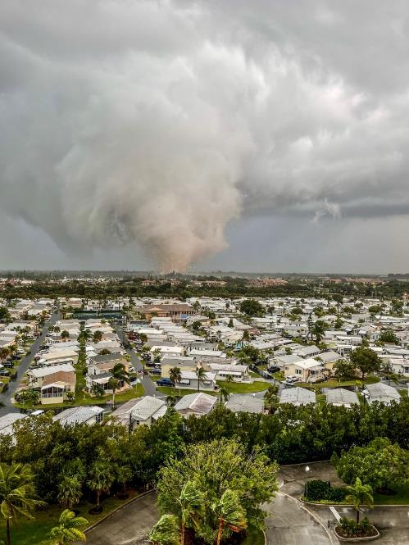
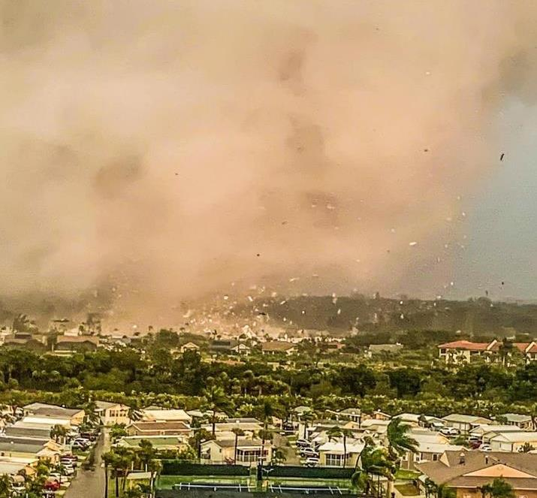
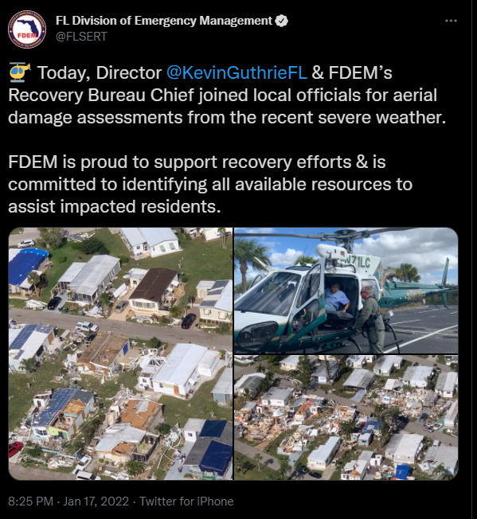
Key Partnerships – Damage Surveys with Emergency Management
January 16, 2022 Fort Myers Tornadoes
0 fatalities, 3 injuries, 45 homes destroyed, 90 homes major damage, $10 million damage

Slide 11
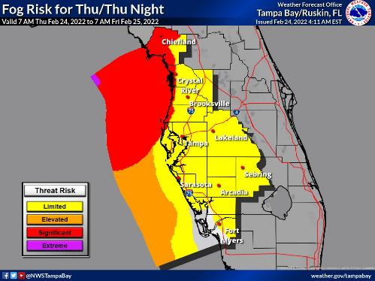
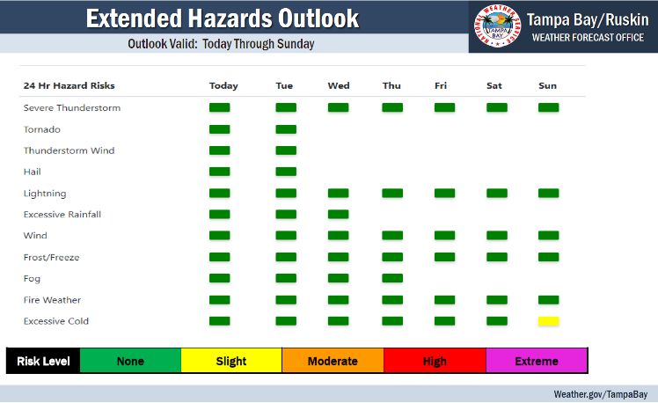
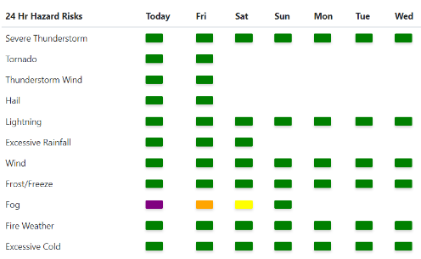
Weekly 10 AM Monday/Thursday Webinars
10 minutes or less
Weather and Ecosystem Hazards
Sea Surface Temps
HAB Outlook
Rain Trends and Outlook
Temperature Trends and Outlooks
Drought information
Outlook Valid: Today through Wednesday
Notes:
https://www.weather.gov/erh/ghwo?wfo=tbw

Slide 12
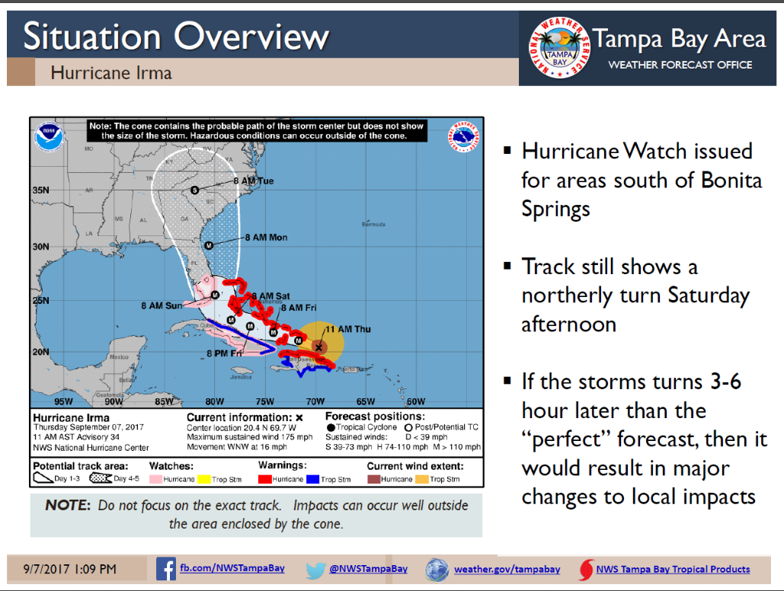
On Demand Decision Support Services
2017 Major Hurricane Irma DSS
Briefed EMs: Sept 4-11, 2017
Emergency Management Webinars: 31
EM Email briefings: 21
EM Phone briefings: 48
Other partner briefings: 93
Last briefing: Oct 7
Supported FEMA Operations in Fort Myers and flooding along Withlacoochee River
Damage surveys: 3

Slide 13
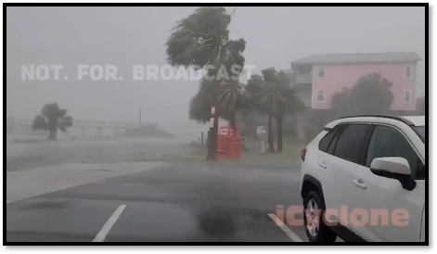
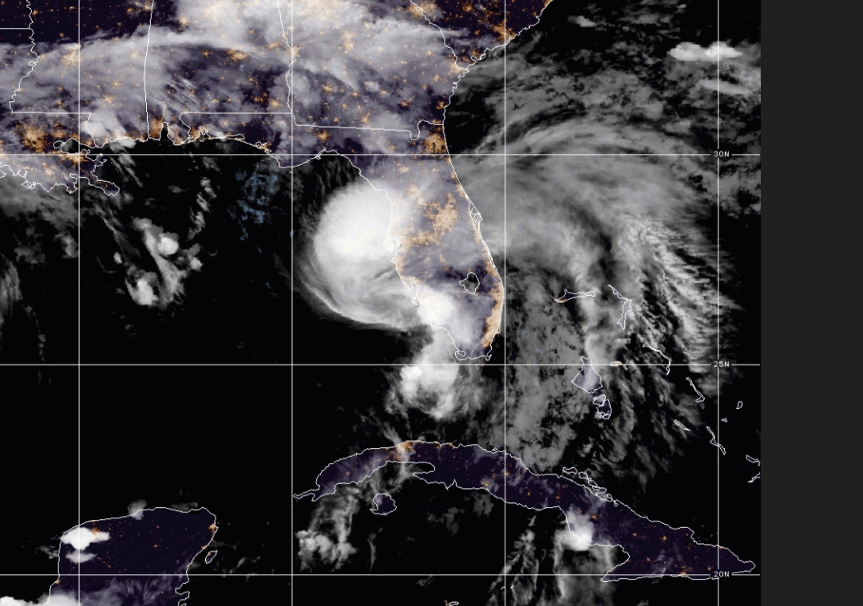
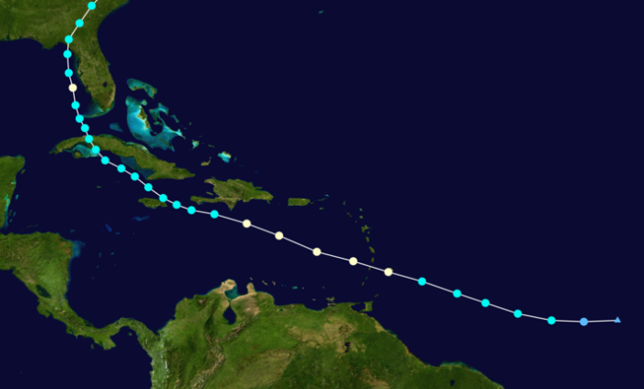
2021 Hurricane Elsa

Slide 14
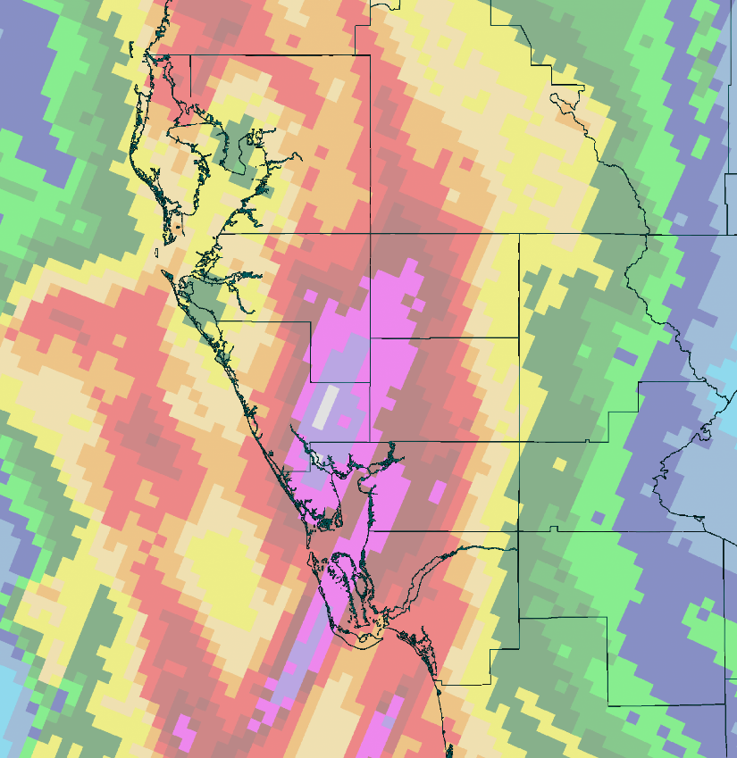
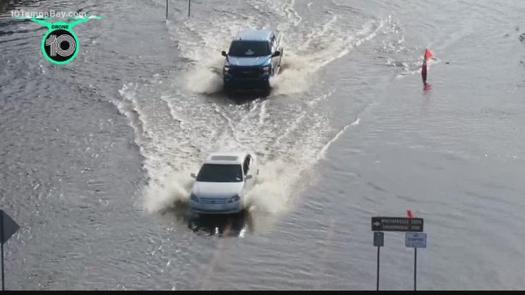
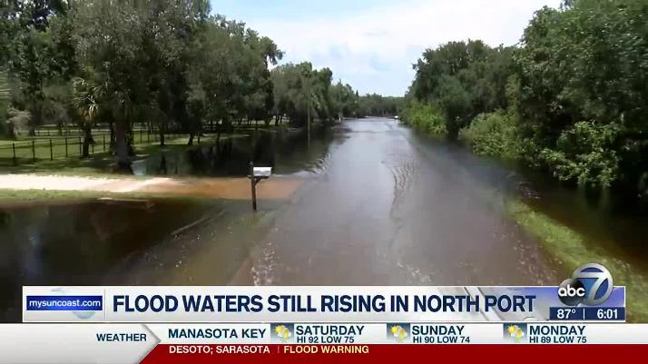
North Port: 200 Homes Surrounded by Water
Rain of 10+ Inches in one day

Slide 15
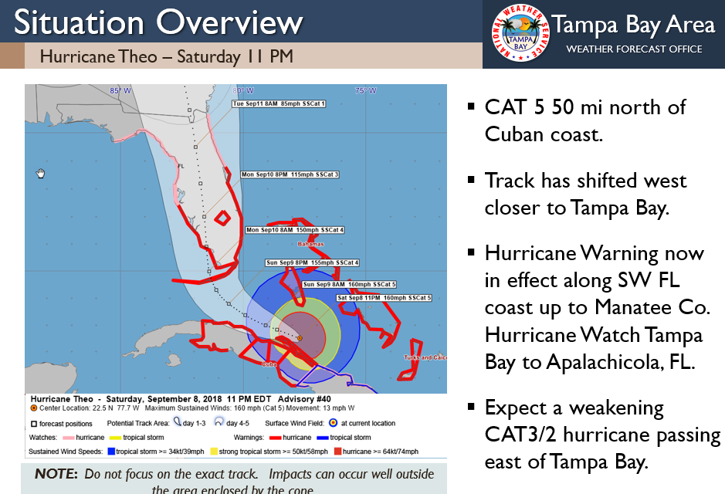
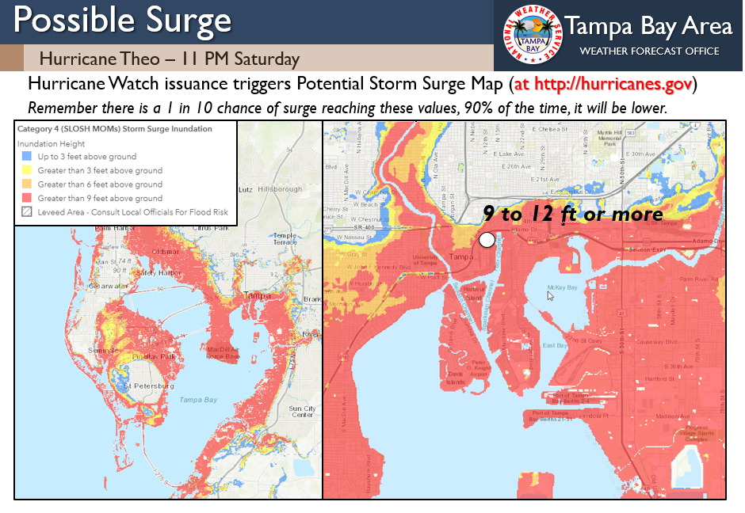
NWS Tampa Bay Can Help Develop Hurricane TTXs

