Slide 1
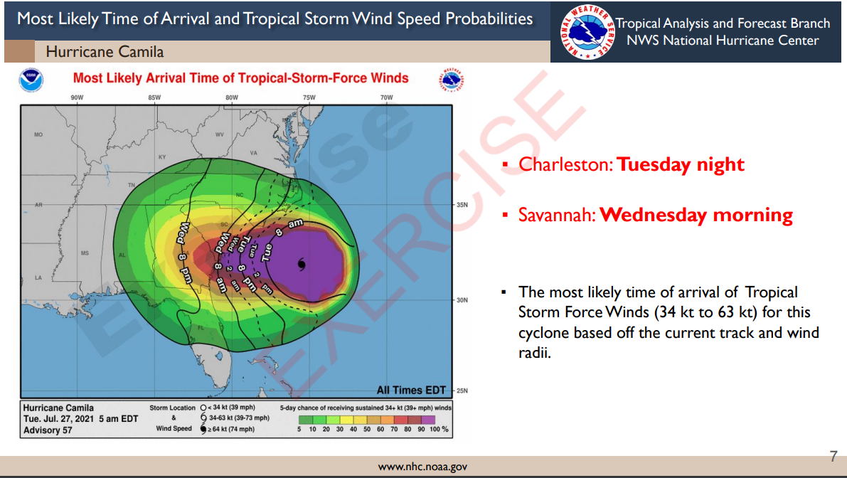
Example of Tropical Briefing

Slide 2
Example of Tropical Briefing

Slide 3
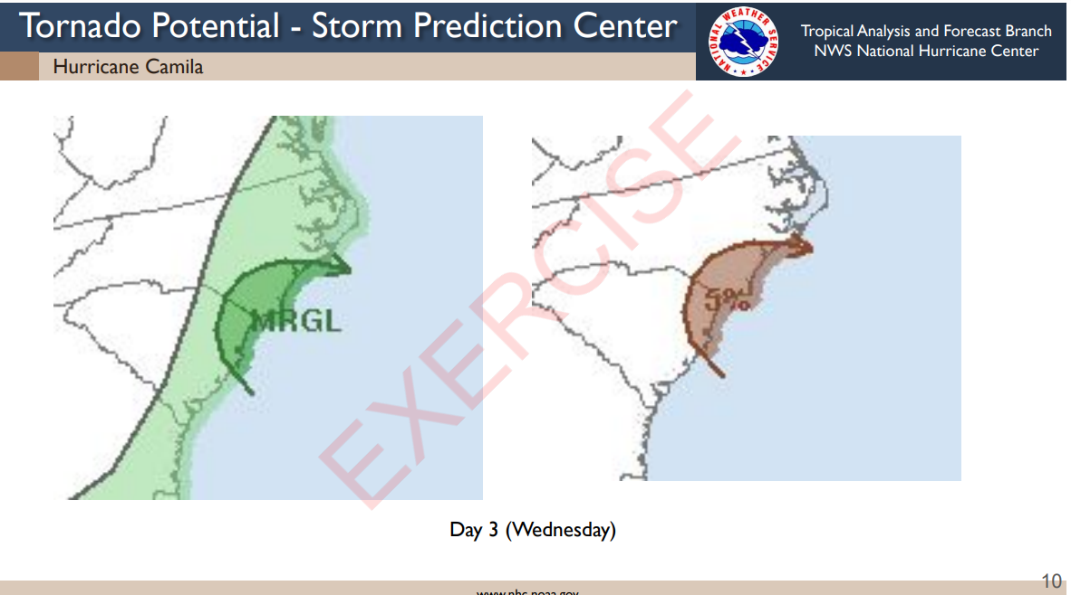
Example of Tropical Briefing

Slide 4
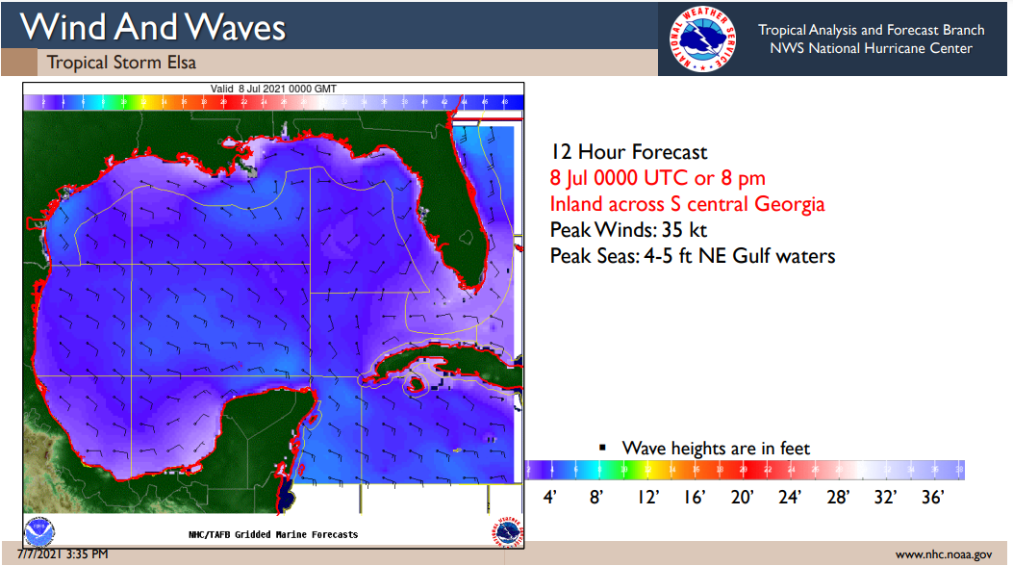
Example of Tropical Briefing

Slide 5
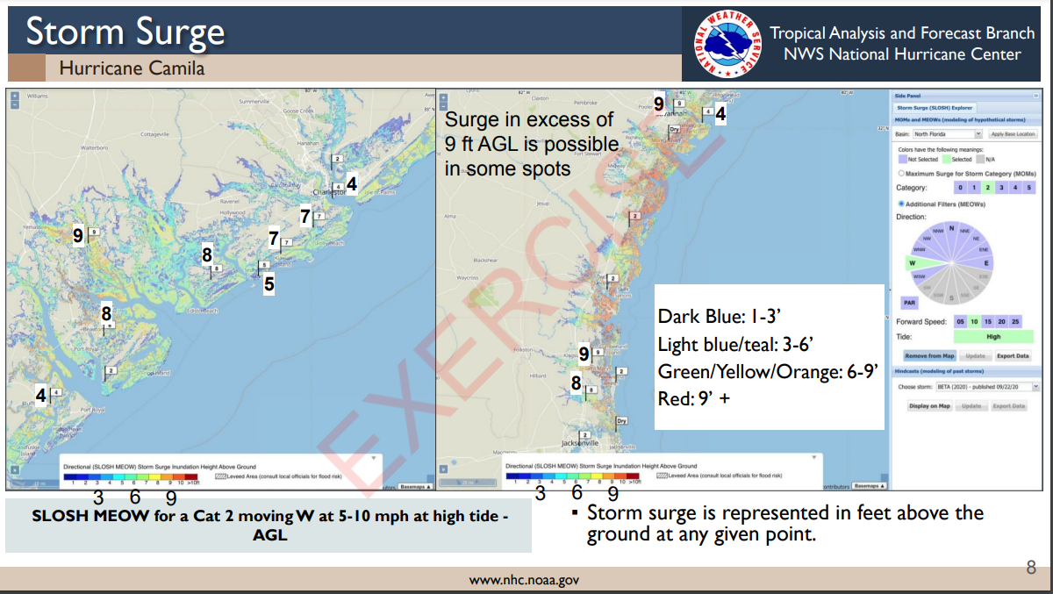
Example of Tropical Briefing

Slide 6
Example of Tropical Briefing

Slide 7
Example of Tropical Briefing

Slide 8
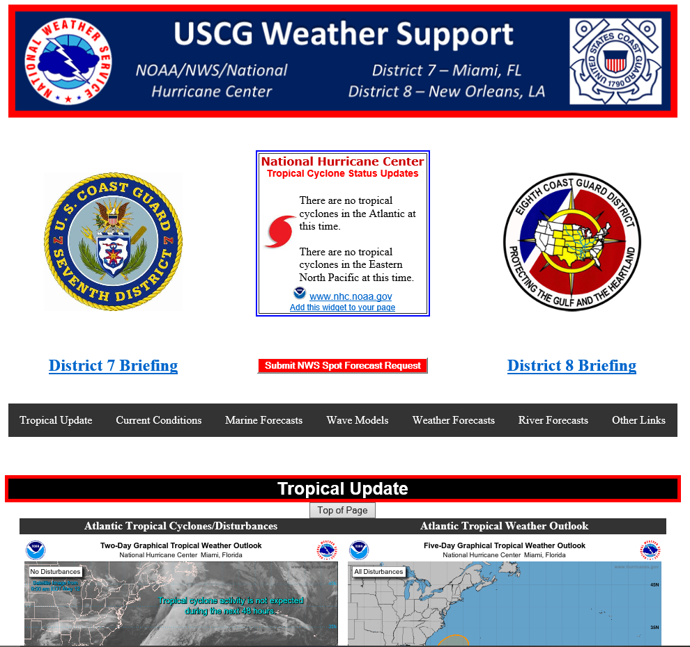
USCG Weather Support Webpage
https://www.nhc.noaa.gov/uscg/
NHC Tropical Cyclone Status Updates
Latest Hurricane Briefings Available to Download
Submit NWS Spot Forecast Request

Slide 9
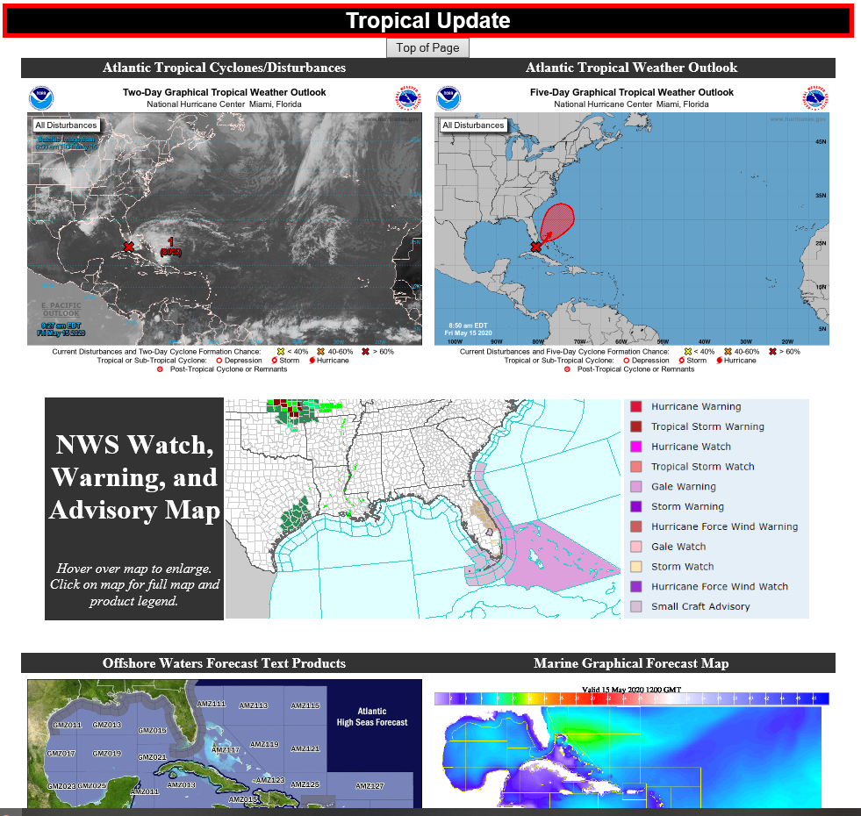
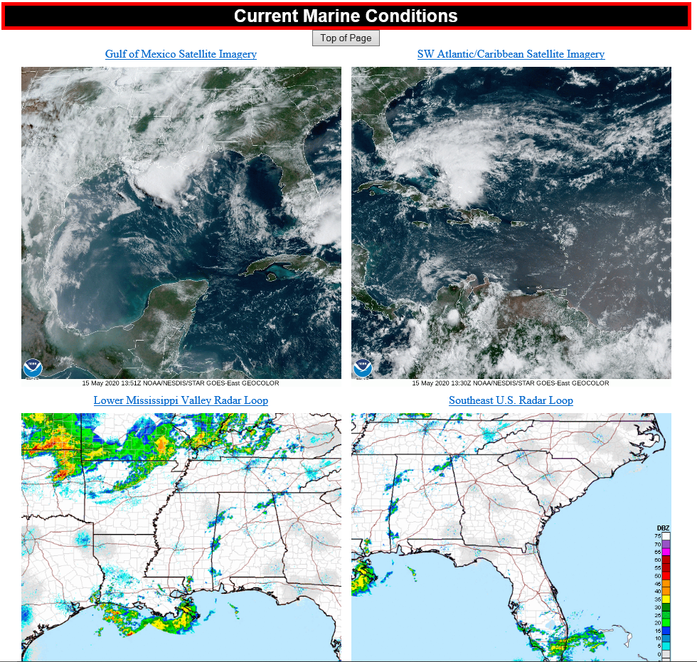
USCG Weather Support Webpage
https://www.nhc.noaa.gov/uscg/

Slide 10
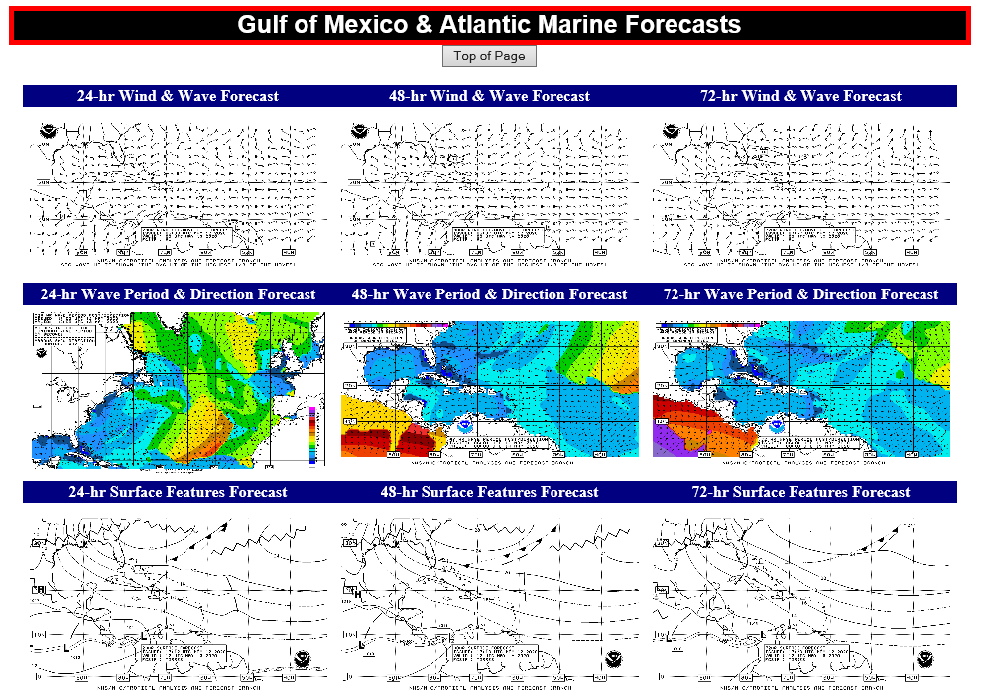
USCG Weather Support Webpage
https://www.nhc.noaa.gov/uscg/

Slide 11
Thank you for your continued partnership!

