Slide 1
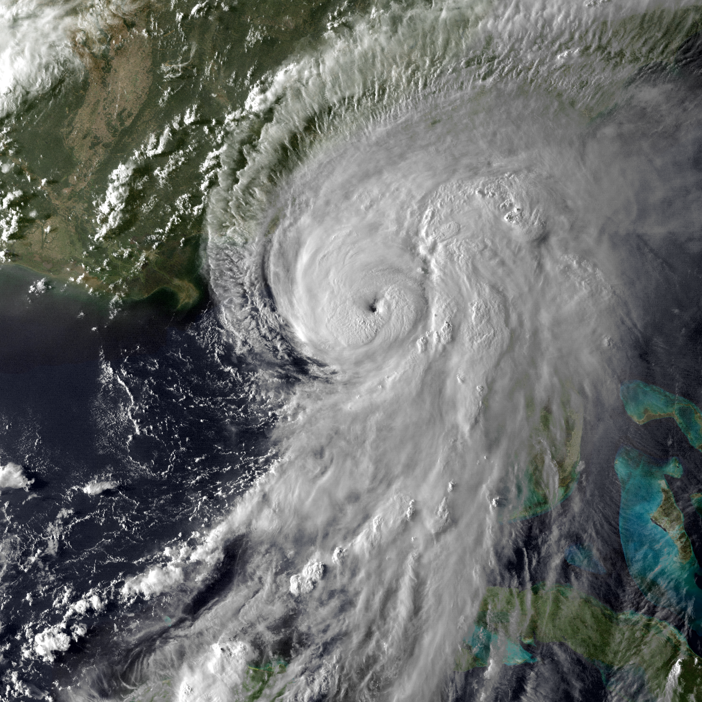
Marine Weather Warning - MWW
All marine zone tropical wind hazards moved to the Marine Weather Warning
Can issue for offshore storms when impacts are not anticipated on land
Hurricane Hermine (2016)
No Significant Land Impacts for Florida East Coast

Slide 2
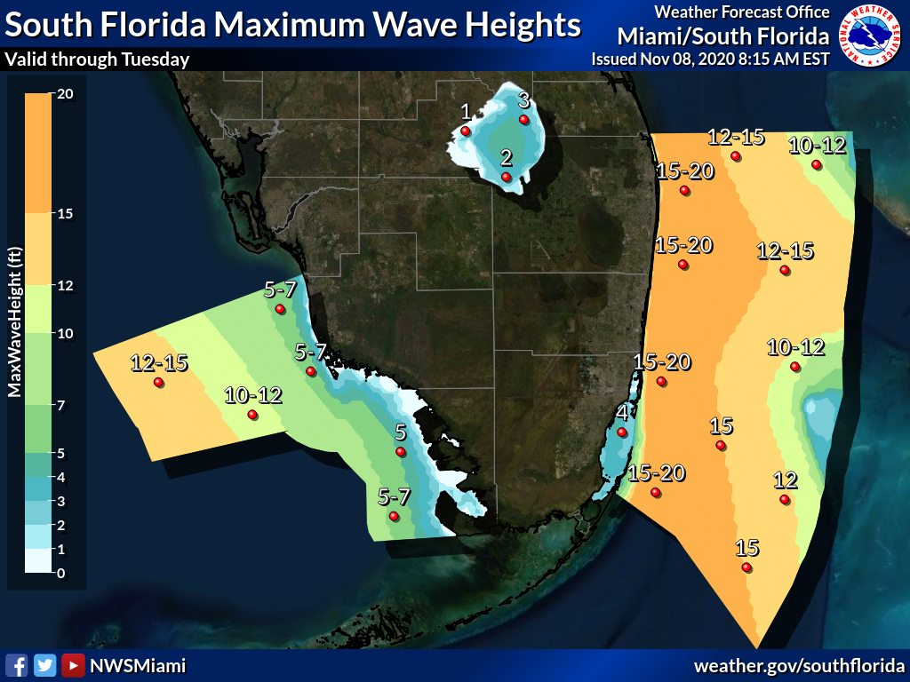
Marine Outlook
Tropical Storm Eta
Atlantic: Lingering into Tuesday
Max values expected Sunday Night into Monday
Gulf: Lingering into at least Wednesday
Max values expected Sunday Night through at least Tuesday
Notes:
Extra 3

Slide 3
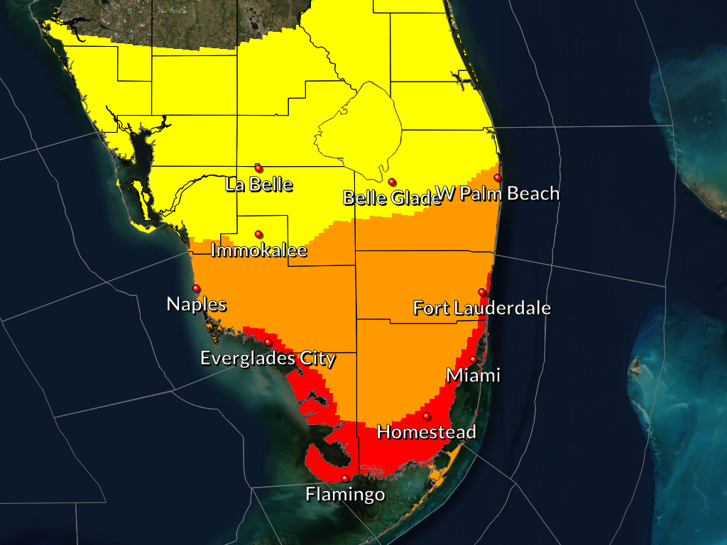
Wind Threat/Potential Impacts
Tropical Storm Eta
Locations of Concern
Portions of Miami-Dade County, coastal Broward County (east of I-95), portions of coastal Collier County and Mainland Monroe County: reasonable worst case scenario of hurricane force wind, mainly in gusts, as depicted in the table above
South of a Fort Myers – West Palm Beach line: High-end Tropical storm force wind which would lead to downed trees and branches, power outages, and blowing around of unsecured lightweight objects
Timing
Sunday afternoon through Monday afternoon (latest along Gulf coast)
WIND THREAT
Be Safe and Prepare For These Potential Conditions
Notes:
Tropical Cyclone Impact Graphic for wind
Include ranges (?) and impacts (?) for each level
Insert mosaic TCIG (insert link here)
Can include link at the bottom for full page/impacts

Slide 4
Potential Tornado Impacts
Tropical Storm Eta
Locations of Concern
All of southern FL
Timing
Sunday night and Monday
TORNADO THREAT
Be Safe and Prepare For These Potential Conditions
Notes:
Only include if threat is moderate or higher

