Slide 1
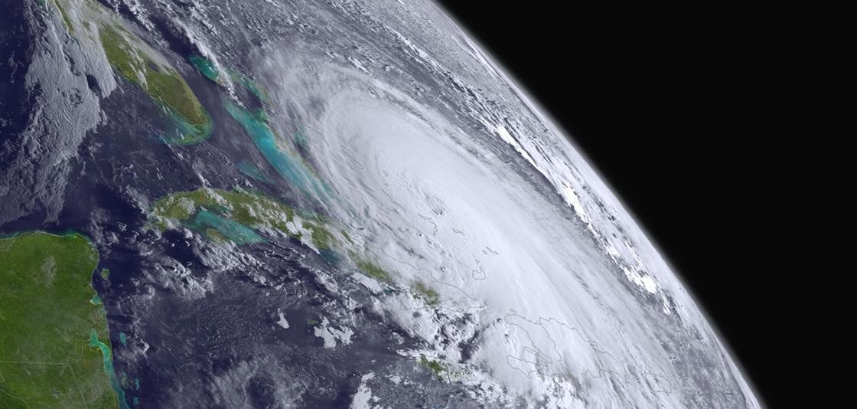
USCG District 7 Visit
NWS Miami : Larry Kelly & Rob Molleda
National Weather
Service

Slide 2
Daily Operations & Tools

Slide 3
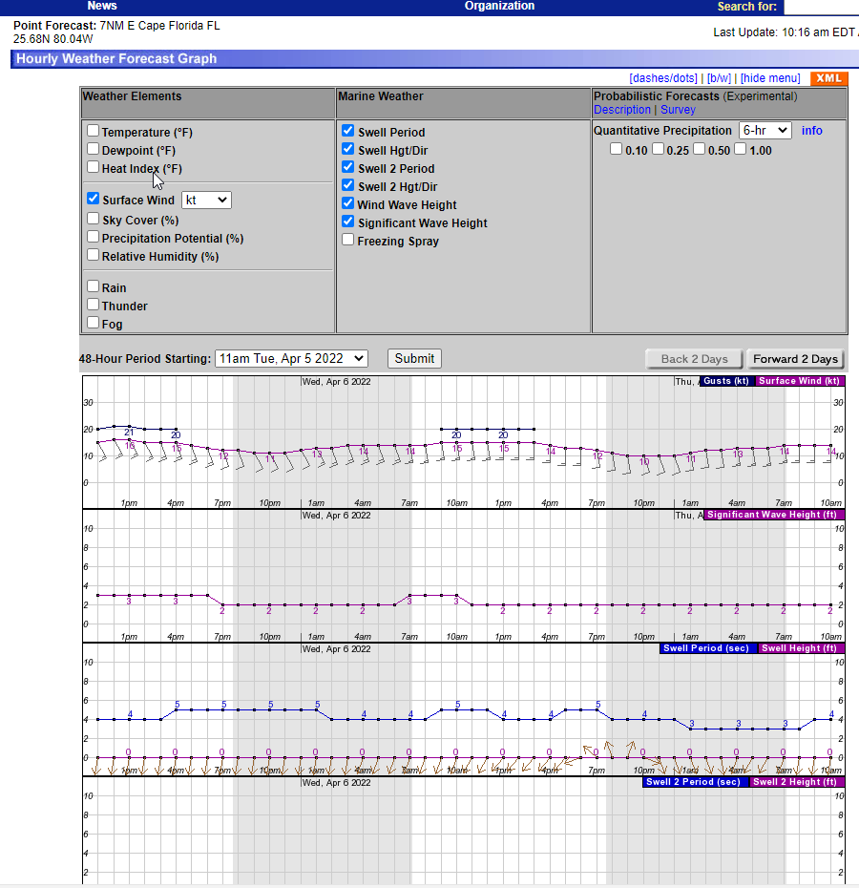
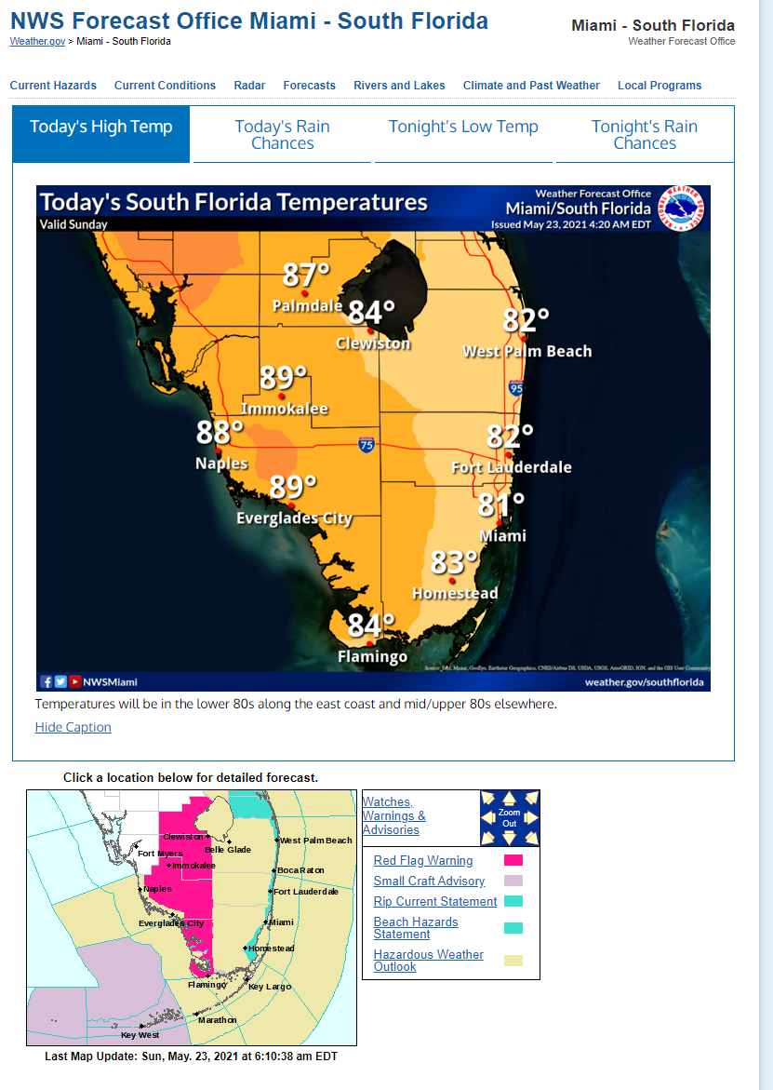
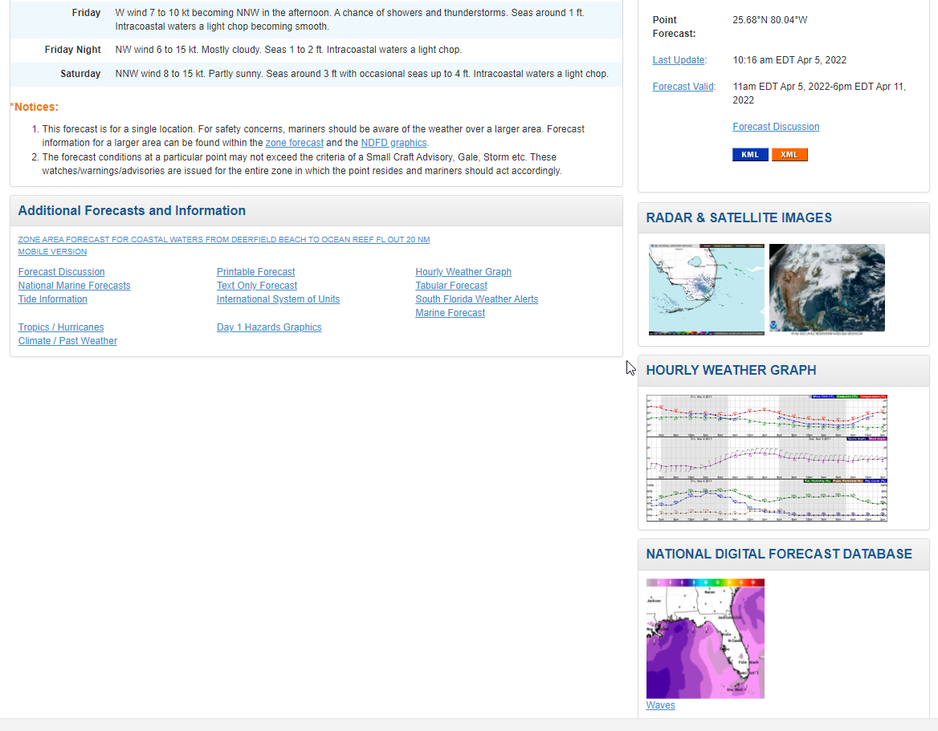
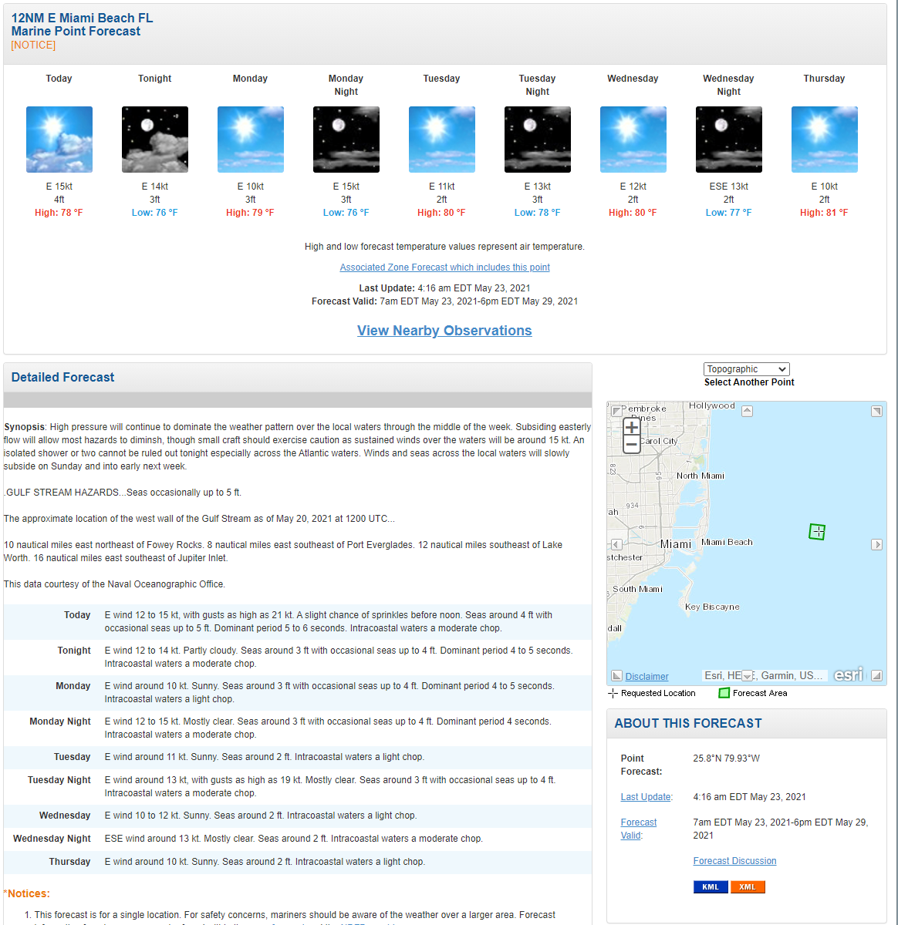
Point & Click
Click anywhere over Marine Area Of Responsibility to get a detailed forecast
Synopsis, Gulf Stream Hazards and Daily Forecast
https://www.weather.gov/mfl
.gov not .com

Slide 4
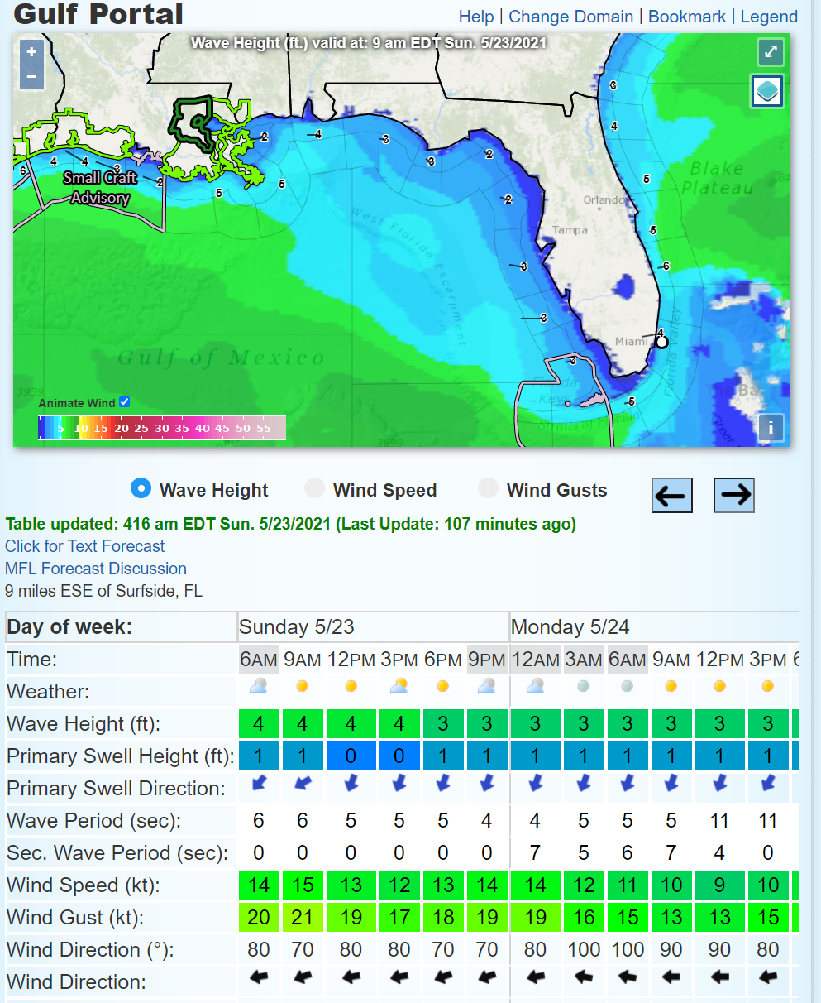
Point & Click Portal
Experimental Marine Portal for forecast
3 hourly forecast for an point, shows advisories, warnings etc.
https://www.weather.gov/greatlakes/?portal=gulf

Slide 5

Routine or Emergency Operations
Nearshore Wave Prediction System Modeling
Point-Click Forecast
Graphical Hazardous Weather Outlook

Slide 6
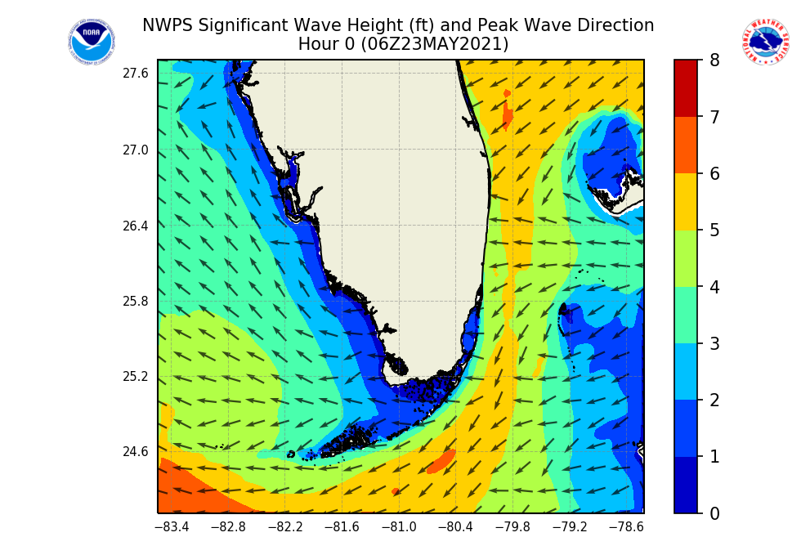
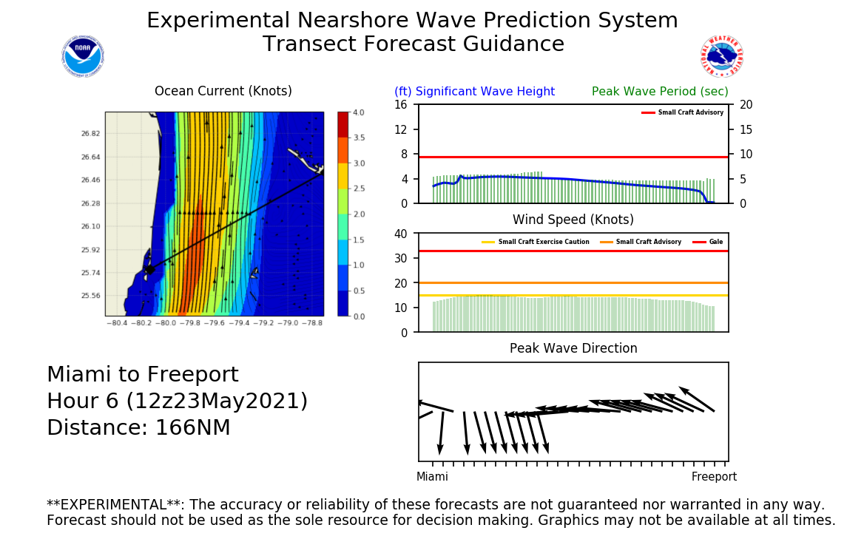
NWPS
Wave Height, Wind Speed, Swell, Wave Period, Current Modeling
Transects can be made custom for USCG operations
https://polar.ncep.noaa.gov/nwps/nwpsloop.php?site=MFL&cg=1

Slide 7
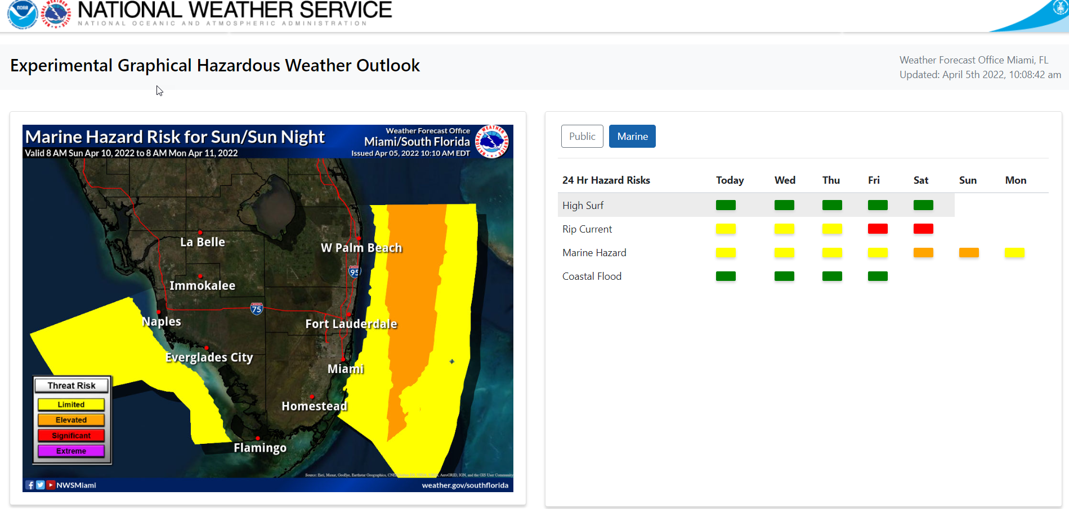
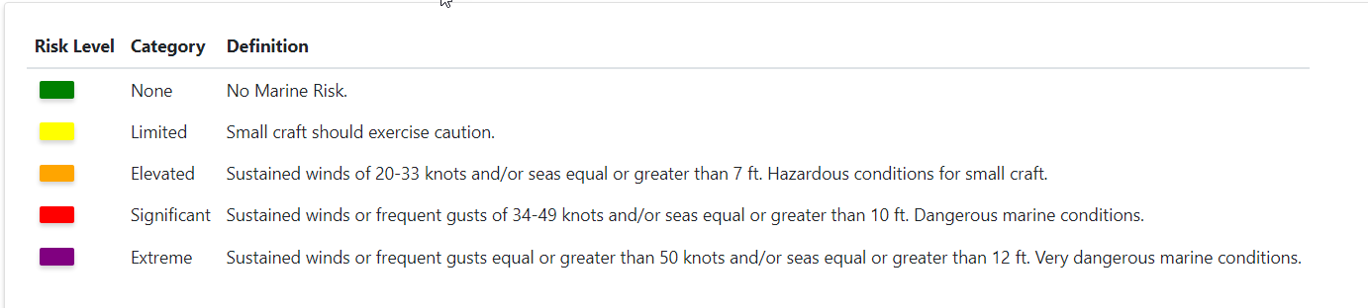
Graphical Hazard Outlook
7 Day Hazard Graphical outlook
https://www.weather.gov/erh/ghwo?wfo=mfl

Slide 8
Decision Support Services (DSS)

Slide 9
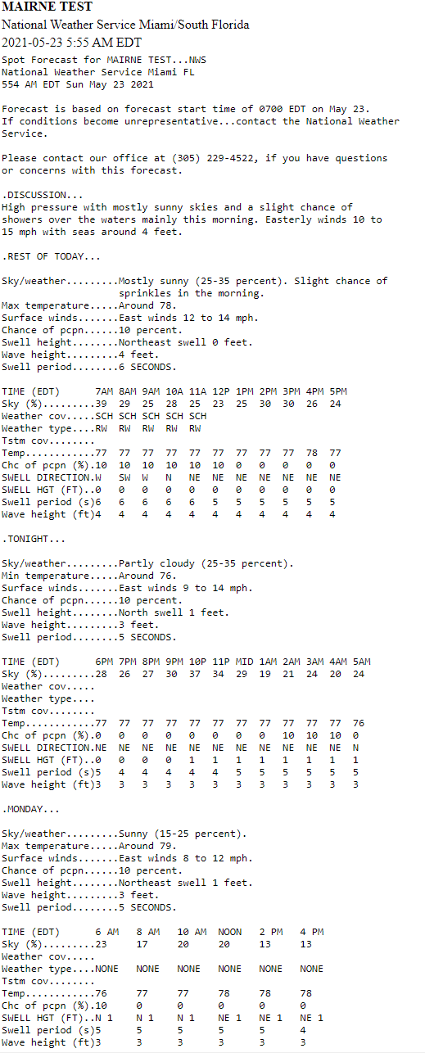
Spot Forecast
Can give a hourly marine/weather forecast for a routine operation or an emergency
Call our duty forecaster to give lat/lon and we will provide the forecast for you
305-229-4525
https://www.weather.gov/spot/request/

Slide 10
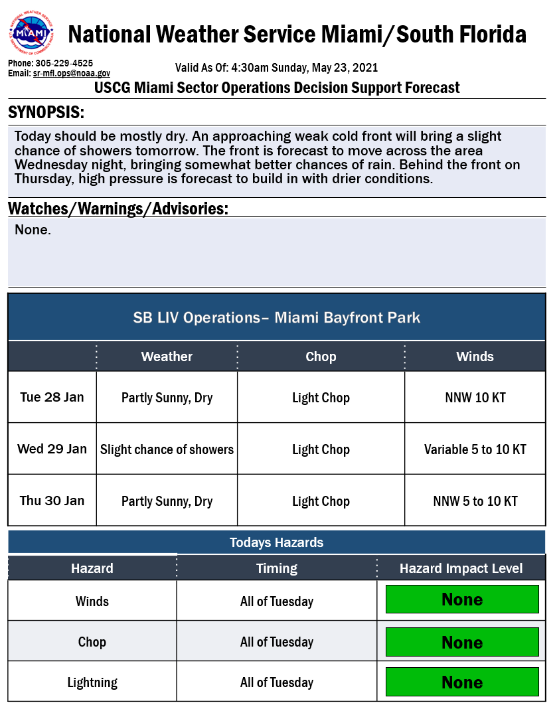
Briefing for Specific Operations

Slide 11
Tropical Ops & Briefings

Slide 12
NHC & NWS Office Forecasts
Working together to provide a clear, consistent, and effective tropical message
National Hurricane Center
Local Forecast Office
Large Scale
Location of interest moves with storm
Storm intensity, track, size
Maximum Wind Values and Probabilities
Broad wind, rainfall, and tornado information
Local scale
Location of interest is the local area of responsibility
Specific local wind, surge, rainfall, and tornado information
Local threats and potential impacts

Slide 13
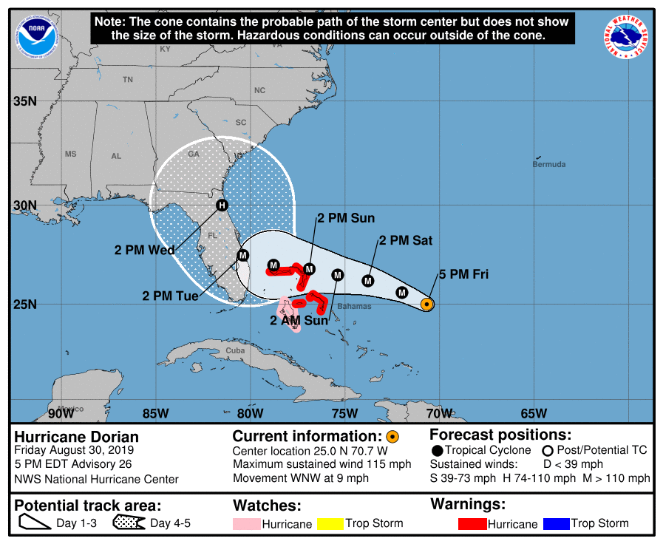
Situation Overview
Hurricane Dorian
What has changed, biggest impact
Brief discussion of any watches or warnings in effect.
Biggest Threats & Impacts
Other caveats/conditions that may affect preparation or long term concerns (heavy rainfall that begins prior, etc).
NOTE: Do not focus on the exact track.
Impacts can occur well outside the area enclosed by the cone.
Notes:
Early in the storm (Days 5-7):
Implicit terms of uncertainty (e.g. too early to include specific timing and impact information) An area of disturbed weather is southeast of the Bahamas, it is still to early to say whether this will pose a threat to Florida.
Forecast Caution (Don’t focus on thin black line, Don’t focus on the exact forecast track, things are likely to change over the next several days, Long range forecasts can change significantly)
Days 3-4:
Expressions of uncertainty are likely being introduced into the CWF and ZFP/PNC – so ensure that what you are saying is consistent with those expressions.
IF warranted, you can discuss intensity in this slide as long as similar wording is in the NHC discussions. Generic terms should be used – This maybe a significant hurricane as it approaches the Mid-Atlantic coast.
Do not discuss intensity trends
Watch/Warning Phase and Ongoing Phase:
In no more than a few bullets, concisely state overall concerns/threat, their trend, and generic statements of potential impacts. Implicitly indicate terms of uncertainty. Avoid specific information for both threats and impacts at this stage. Address threats and potential impacts generically only from those hazards that are a concern at the time.
Ongoing/Landfall Phase:
Due to the fact that this briefing is likely taking place around or just after landfall, there is a shift in focus to more rapid-response type operations (search and rescue, etc)…but also needs to factor in recovery efforts that will be taking place in the next few days.
Wrap-Up Phase:
Generally not a recommended slide during wrap up

Slide 14
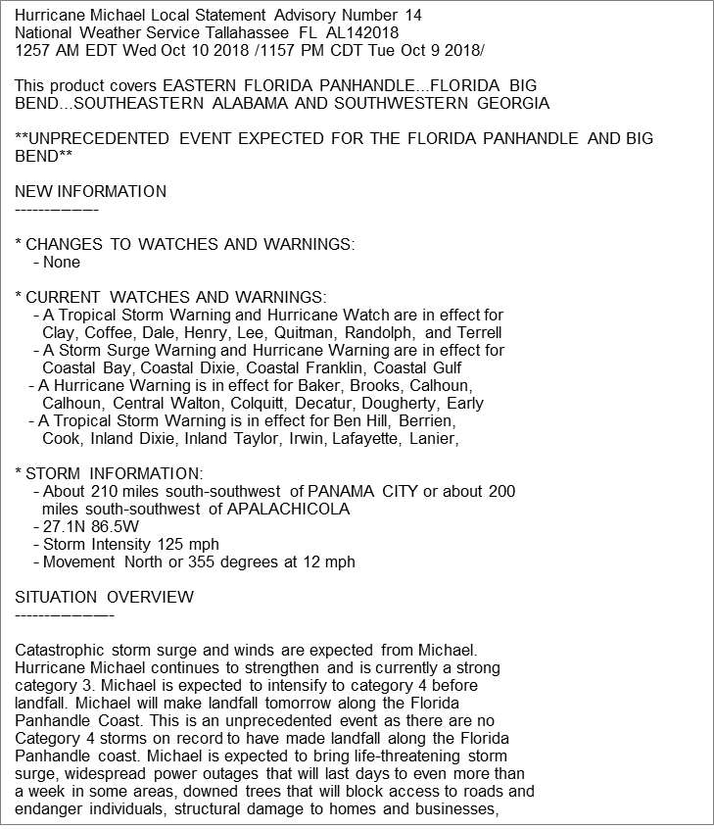
Hurricane Local Statement - HLS
Land only product
Broadcasts on NOAA Weather Radio
Overview of tropical impacts across the WFO’s Area of Responsibility

Slide 15
Hurricane Local Statement - HLS
Affected Area
Headline/Primary Message
New Information since last storm update
Overview of Situation
Generalized Threat Assessment
Generalized impacts for area

Slide 16
Hurricane Local Statement - HLS
Potential Impact Sections:
  Wind
  Surge
  Flooding Rain
  Tornadoes
POTENTIAL IMPACTS
-----------------
* WIND:
Prepare for life-threatening wind having possible devastating impacts
across West Central and Southwest Florida. Potential impacts include:
- Structural damage to sturdy buildings, some with complete roof
and wall failures. Complete destruction of mobile homes. Damage
greatly accentuated by large airborne projectiles. Locations
may be uninhabitable for weeks or months.
* SURGE:
Prepare for life-threatening surge having possible devastating
impacts across the Tampa Bay region and all of southwest Florida. Potential
impacts in this area include:
- Widespread deep inundation, with storm surge flooding greatly
accentuated by powerful battering waves. Structural damage to
buildings, with many washing away. Damage greatly compounded
from considerable floating debris. Locations may be
uninhabitable for an extended period.
* FLOODING RAIN:
Prepare for life-threatening rainfall flooding having possible
extensive impacts across west central and southwest Florida.
Potential impacts include:
- Major rainfall flooding may prompt many evacuations and rescues.
* TORNADOES:
Prepare for a dangerous tornado event having possible significant
impacts across West Central and Southwest Florida. Potential impacts
include:
- The occurrence of scattered tornadoes can hinder the execution
of emergency plans during tropical events.

Slide 17
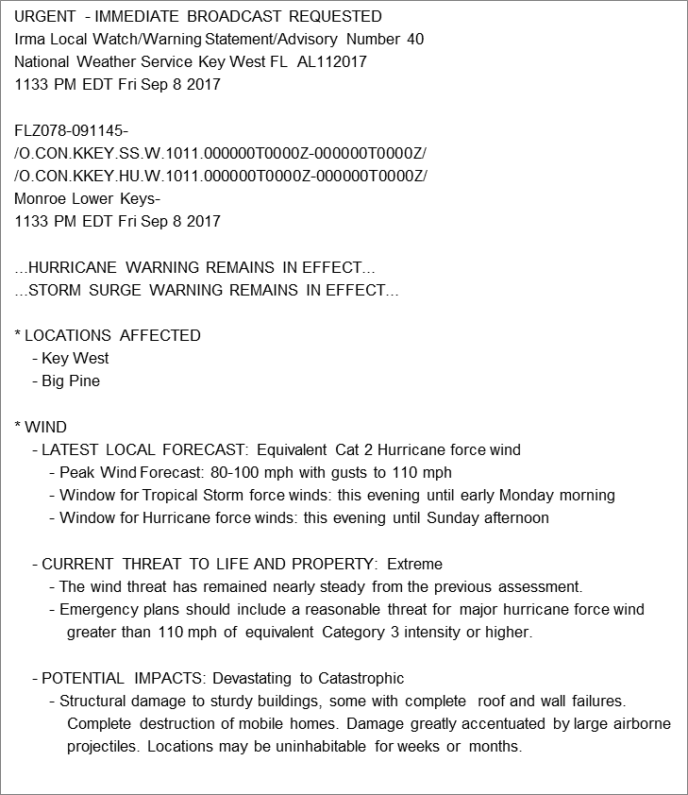
Tropical Cyclone Watch/Warning
Product – TCV
Info by County Zone
Contains Watch/Warning coding
Forecast information by Hazard
  Where, What, When, How Long
NOT made to READ in entirety - parsed for web display and other apps
Triggers Emergency Alert System (EAS) & TV Crawls

