Slide 1
Joint Hurricane Testbed (JHT)
2011 Update
Transition from Research to Operations
Jiann-Gwo Jiing
JHT Director
NHC
Shirley Murillo
NOAA/HRD
Chris Landsea
NHC
65th Interdepartmental Hurricane Conference
Miami, FL
March 3, 2011

Slide 2
Joint Hurricane Testbed Mission Statement
The mission of the Joint Hurricane Test Bed is to transfer more rapidly and smoothly new technology, research results, and observational advances of the United States Weather Research (USWRP), its sponsoring agencies, the academic community and other groups into improved tropical cyclone analysis and prediction at operational centers.

Slide 3
JHT Process
Principal Investigators apply for funding through NOAA
A seven member Steering Committee rates all proposals
Funded projects are tested during one or two hurricane seasons in conjunction with NHC/ Environmental Modeling Center points of contact
At the project’s end, each are evaluated by NHC/EMC staff
Implementation of successful projects are then carried out by NHC/EMC staff/PIs

Slide 4
Summary of JHT projects
2001-2010
1) Number of projects supported: 62
  51 completed
    35.5 accepted for operational implementation
    Number of projects completed but rejected: 6
    Number of projects completed but pending further investigation (decisions deferred): 9.5
  Number of projects in process: 11
2) Implementation
  Number of projects implemented: 31.5
    Number of numerical modeling related projects implemented by EMC/NCO: 10
    Number of projects implemented by NHC: 21.5
  Number of projects accepted but not yet fully implemented by NHC: 4
Note:
1) Implementation is defined when a project is completed, accepted, and the technique installed on NCEP/NCO or NHC operational systems and runs on operational time frame.
Some techniques were “implemented” on JHT platform for testing.

Slide 5
Changes in Funding Distribution
Second Round (2003-2005)
$1.35M
Fifth Round (2009-2011) $1.15M

Slide 6
Current (5th Round) Project Focus Areas
Primary Area of Focus | # of Projects
Improvements to dynamical models (for track, intensity, and precipitation forecasts) | 5
Statistical intensity forecast guidance | 3
Enhancements to observed data, assimilation | 1
Tropical cyclone structure/wind/wave distribution | 1
Enhancements to operational environment | 1
Total | 11

Slide 7
2010 Major Activities
Completion of the fourth round (2007-2009) projects
  Completed in August (December) 2009
  JHT final evaluation/report on 4th round projects
    February 2010
  Decision on acceptance for implementation (NHC and EMC Directors)
    4 criteria for acceptance
    Decisions made April 2010
      4 projects accepted
      6 projects deferred pending further evaluation
      1 no decision
  Implementaton
    4 implemented: 1 by EMC/NCO & 3 by NHC

Slide 8
2010 Major Activities
Cont.
Second year funding renewal for 5th round projects – April - June 2010
Testing of 5th round projects
  Collaboration with PI
  Programming
  Establishing data flow
  Generating output for forecaster use/evaluation

Slide 9
2010 Major Activities
Cont.
Preparation for 6th round projects
  Draft Federal Funding Opportunity (FFO)
    Update Centers priorities
    Evaluation criteria
  FFO published early July
  SC Review of Pre-applications (how many)
  PIs submitting full proposals (how many)
  SC Review of full proposals (completed)

Slide 10
Forecaster Priorities
Second Round (2003)
Intensity change, rapid intensification
“Guidance on guidance” for track, intensity and precipitation – probabilistic
Precipitation amount and distribution
Reduce the occurrence of guidance and official track outliers
Implement improved observational systems in the storm and its environment
Sixth Round (2011)
intensity change, rapid intensification
Improved observational systems in the storm and its environment
Guidance on guidance for track, intensity and precipitation
Storm surge, coastal inundation modeling/applications
Improved and extended track guidance) and identify and removal of outliers

Slide 11
Modeling Priorities
(Provided by EMC)
Second Round (2003)
Improved model development to advance track and intensity forecasts
Improved boundary layer representation for coupled air/sea/land models-hurricane rainfall and inland flooding problem
Improved targeting strategies for hurricane surveillance missions
Transforming results from field programs, e.g., Coupled Boundary Layers/Air-Sea Transfer (CBLAST), into tangible results for NWP models.
Diagnostic studies of storm scale structure changes from high resolution models
Sixth Round (2011)
General model improvements to advance NCEP global model track forecasts, improve 5-7 day
Diagnostic techniques to further increase the utility of global models in forecasting tropical cyclone genesis
Improvements specific to operational HWRF modeling system

Slide 12
Challenges for FY11
Sixth round funding recommendation
  35 LOI and 25 full proposals
  Steering committee review proposals – Complete Feb 2011
  Rank and select proposals for funding
  Work with Grants Office to fund selected projects
  Find Point of contacts among NHC forecasters and support staff
  Work with PIs to setup timelines for their projects
Test and evaluation
  Prepare real-time testing & evaluation for 5th round projects
  Set up necessary software code and data flow.
Completion of 5th round projects
  Final reports for 5th round projects
  POC feedback
  JHT final review/reports to NHC Director for acceptance
Implement newly accepted projects (NHC)

Slide 13
Acknowledgements
  JHT Steering Committee
  Shirley Murillo, JHT Admin. Asst.
  Chris Landsea, NHC SOO and JHT Admin. Asst.
  Jose Salazar, JHT meteorologist/programmer
  NHC and EMC forecaster and points of contact
  NHC/Technical Support Branch staff
  JHT principal investigators and other funded participants
  USWRP
  NOAA/OAR Office of Weather and Air Quality
  NHC admin staff

Slide 14
NHC Contributions to JHT
Logistics
Dedicated physical space in operations, offices
Personnel
NHC dedicating about 1.5 FTE spread across ~12 people
  0.5 FTE reimbursed by USWRP for quarter-time JHT Director and one quarter-time JHT administrative assistant
  NHC contributing 1.0 FTE, including NHC member on JHT Steering Committee, forecasters, and technical support staff
Forecaster and technical points of contact (POC)
Programming, system administration, and network support
Administrative support
Computing Resources
Network connectivity
Operational data flow

Slide 15
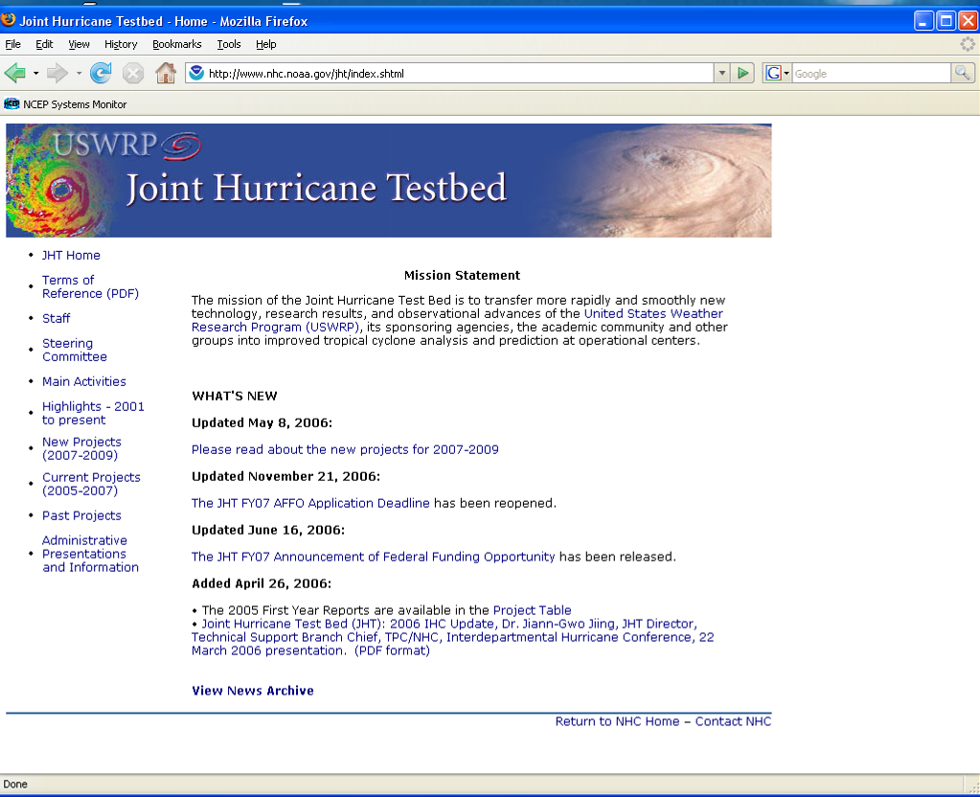
JHT Website
Go to www.nhc.noaa.gov

Slide 16
Thank you

Slide 17
Supplemental Slides

Slide 18
JHT Infrastructure
Personnel
Quarter-time Director (NOAA FTE)
7-member Steering Committee
  Three from NOAA (one TPC), two from DOD, and two from the academic community
  TPC member serves as co-Chair
Two quarter-time administrative assistants (NOAA FTE)
One IT Facilitator (meteorologist/programmer)
Computing Resources
Server and workstations
Software

Slide 19
JHT 5th Round Projects - Dynamical model upgrades
Proposal Title | PIs | POC
Hurricane Model Transitions to Operations at NCEP/EMC | Tuleya (SAIC) | Pasch, Blake, Landsea
Improving the Hurricane WRF-Ocean Coupled System for Transition to Operations | Ginis (U Rhode Island) Bender (NOAA/GFDL) | Pasch, Cangialosi, Landsea
Evaluation and Improvements of Cloud and Precipitation Physics in the Operational Hurricane WRF Model at NOAA/EMC | Wang (U Hawaii) Phillips (U Hawaii) | Brennan, Landsea
Evaluation and Improvement of Ocean Model Parameterizations for NCEP Operations | Shay (U Miami) Halliwell (U Miami) | Avila, Schauer, Landsea
Improving Predictability of the Atlantic Warm Pool in Ocean Model for Assistance to Operational Hurricane Forecast | Wang (NOAA/AOML) Lee (NOAA/AOML) | Pasch, Schauer, Landsea

Slide 20
JHT 5th Round Projects -
Statistical intensity forecast guidance, Tropical cyclone structure/wind/wave distribution, Enhancements to operational environment
Proposal Title | PIs | POC
Advanced Applications of the Monte Carlo Wind Probability Model | Kidder (CSU) DeMaria (NOAA/NESDIS) | Brennan, Berg, Lauer, Landsea
ATCF Requirements, Intensity Consensus and Sea Heights Consistent w/ NHC Forecasts | Sampson (NRL) | Avila, Brown, Sisko, Christensen, Landsea
In-Flight Data Processing for the Wind Swath Radar Altimeter (WSRA) for Real-Time Reporting of Directional Ocean Wave Spectra from the NOAA WP-3D Hurricane Reconnaissance Aircraft | PopStefanjia (ProSensing) | Beven, Brown, Lauer, Landsea
Improvement in the Rapid Intensity Index Incorporation of Inner Core Information | Kaplan, Cione, Dunion (NOAA/AOML) Dostalek (CIRA/CSU) DeMaria, Knaff (NOAA/NESDIS) Lee (NRL) | Avila, Kimberlain, Blake, Sisko, Landsea
Improved Real-Time Hurricane Ocean Vector Winds from QuikSCAT | Jones (U Central Florida) Uhlhorn (NOAA/AOML) Chang, Zelenak (NOAA/NESDIS) | Brennan, Beven, Landsea
A New Secondary Eyewall Formation Index: Transition to Operations and Quantification of Associated Intensity Changes | Kossin (U Wisconsin/CIMSS) | Kimberlain, Berg, Sisko, Landsea
Development of a Unified Dropsonde Quality Assurance and Visualization Capability | Black (NOAA/AOML) Martin (NCAR/EOL) | Franklin, Landsea

Slide 21
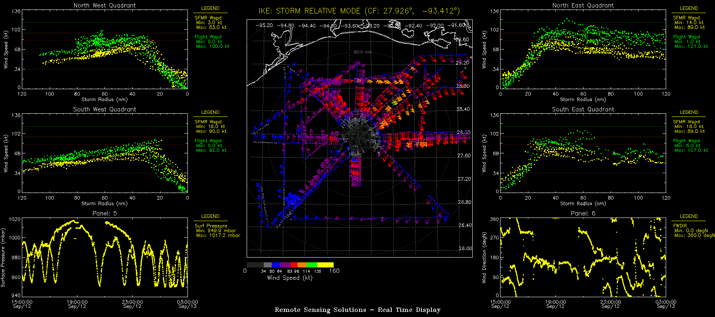
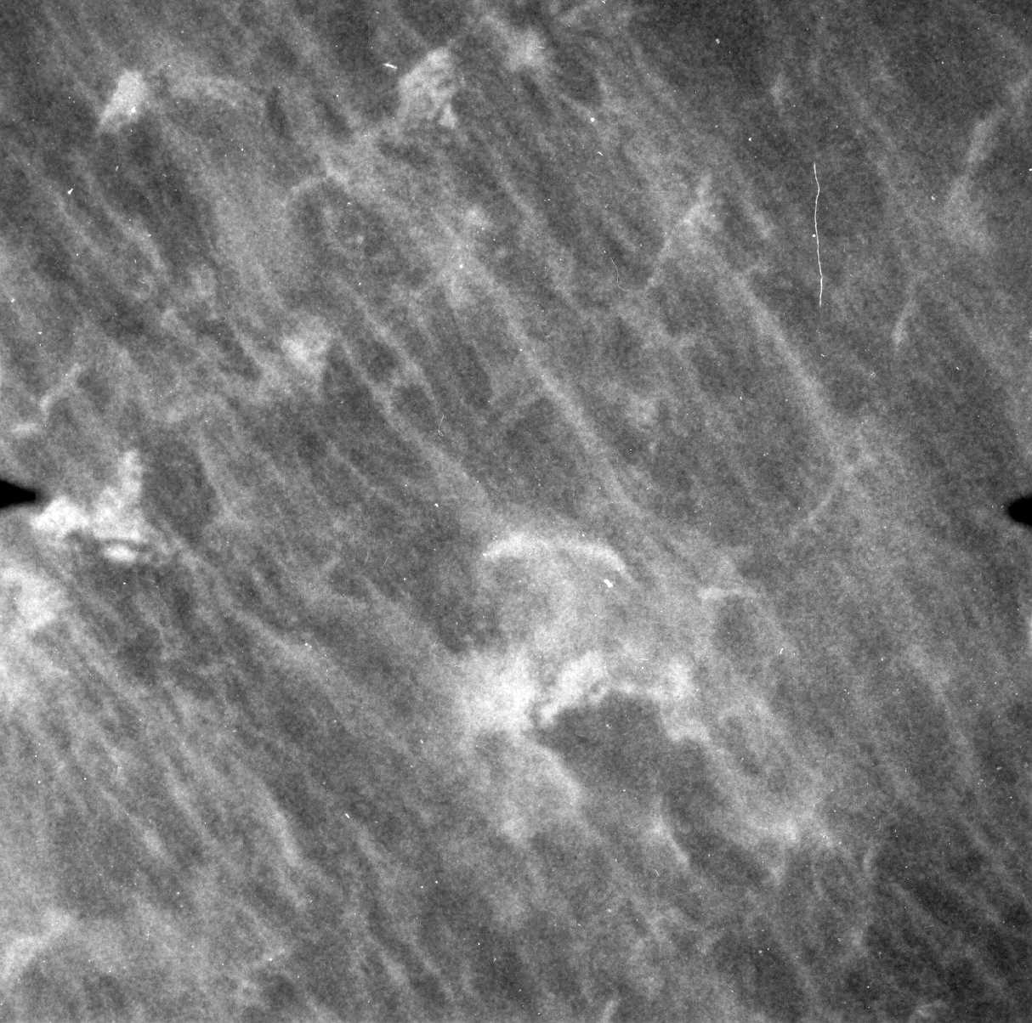
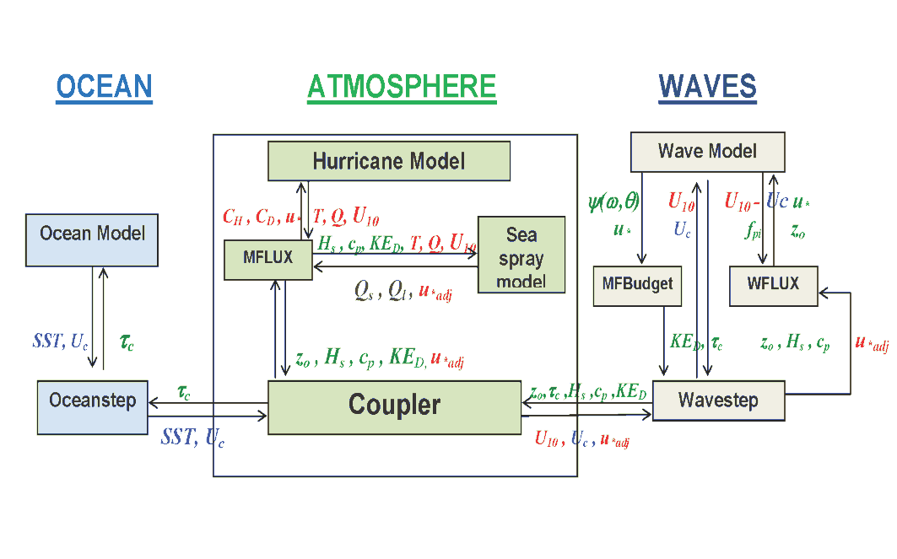
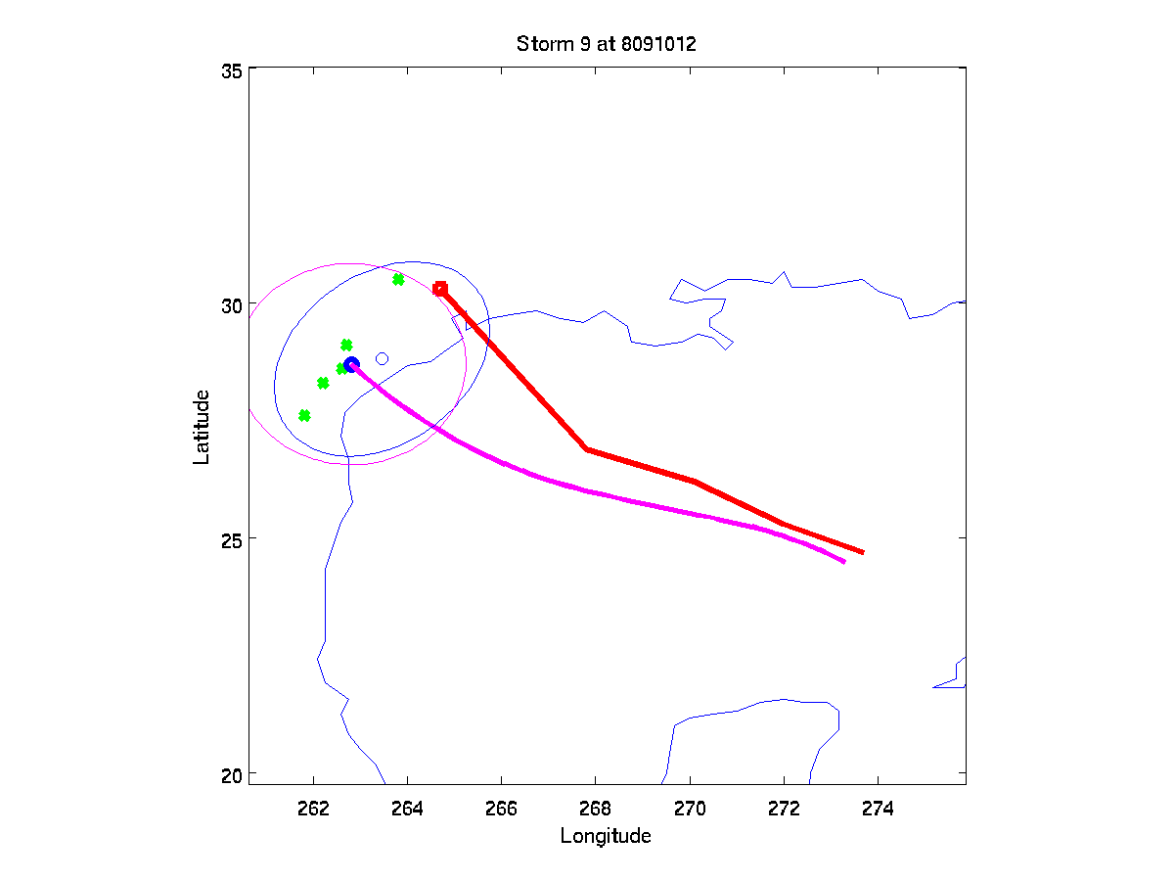
Highlights of 4th Round Completed Projects
Sea Spray
Atmosphere
Ocean surface whitecaps and foam streaks in a hurricane at wind speeds of ~46 m/s
Ocean
by P. Black
Sea Spray Parameterization – Bao/Fairall
Visualization Tool & SFMR – Carswell/Uhlhorn
Coupled TC-Wave-Ocean - Ginis
TC Dressing – Hansen

Slide 22
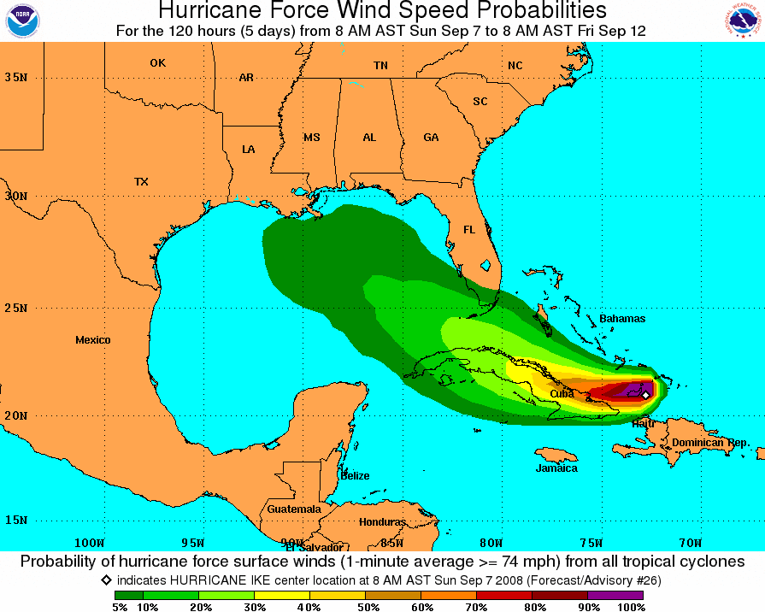
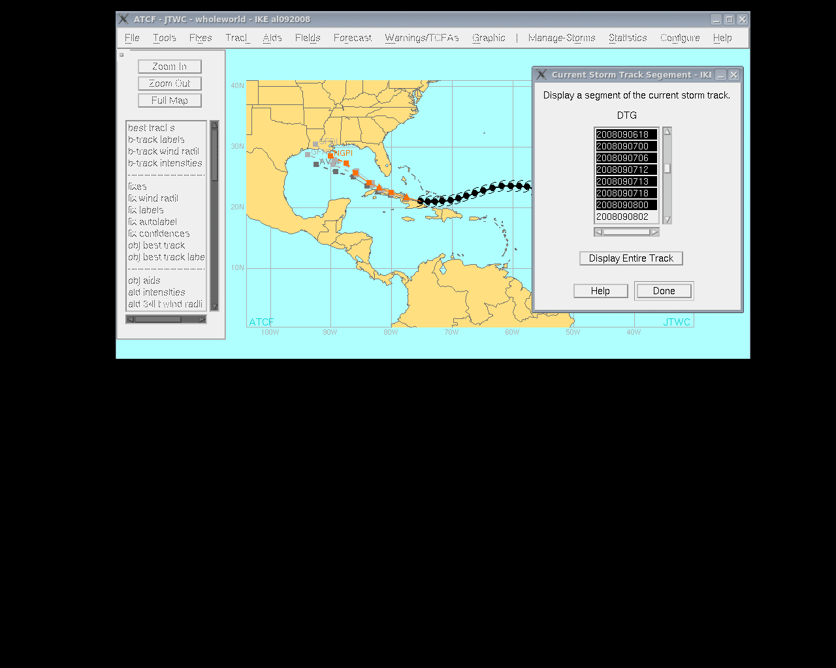
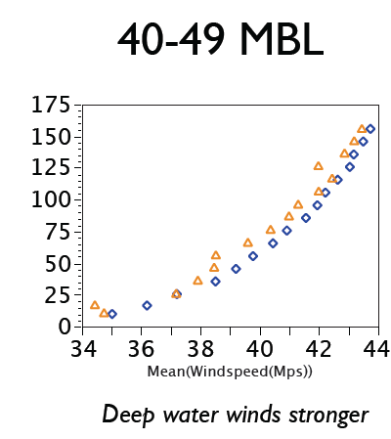
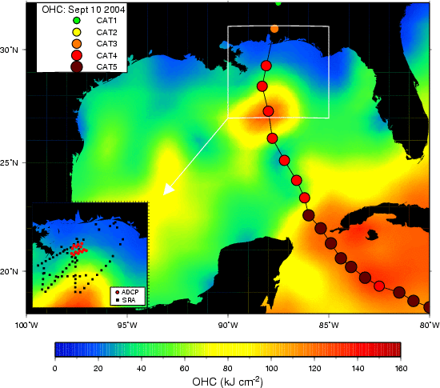
Highlights of 4th Round Completed Projects
Improved Wind Probabilities – DeMaria/Knaff
Enhanced ATCF - Sampson
Drag Coefficient in Shallow Water - Powell
Ocean Model Parameterizations - Shay

Slide 23
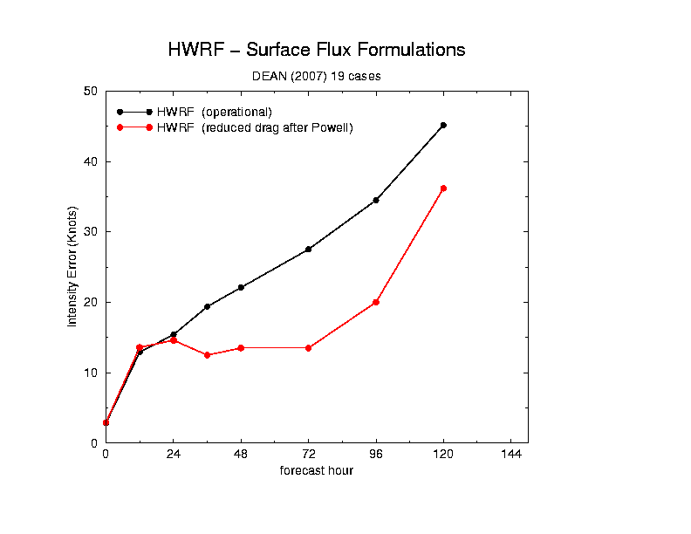
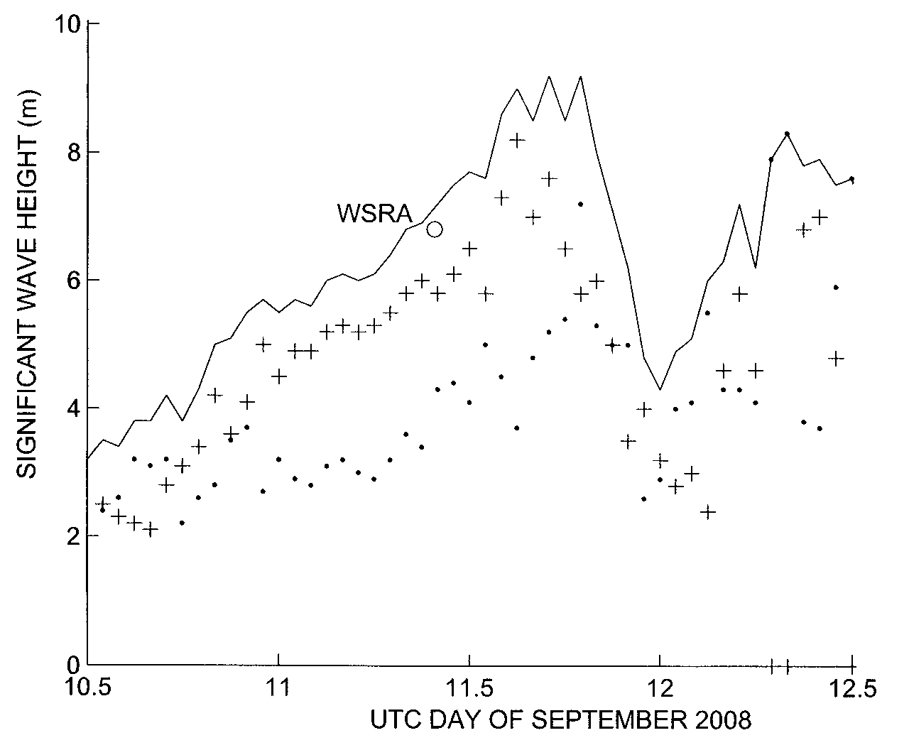
Highlights of 4th Round Completed Projects
HWRF Transition - Tuleya
Waves from Aircraft - Walsh

