Slide 1
JHT Project:
Evaluation and Improvements of Cloud and Precipitation Physics in the
Operational Hurricane WRF Model at
NOAA/EMC
Yuqing Wang
Department of Meteorology, University of Hawaii
The 65th IHC, February 28-March 3, 2011

Slide 2
Overall Goal of the Project
To evaluate and improve the cloud and precipitation physics used in the operational Hurricane Weather Research and Forecast (HWRF) model developed in the Environmental Modeling Center (EMC) at the National Centers for Environmental Prediction (NCEP) of NOAA, achieving improved prediction of hurricane structure and intensity, including the size, by the HWRF model at NCEP/EMC.

Slide 3
Objectives
• To diagnose the discrepancies of the current cloud and precipitation physics and the interaction between grid-scale moist processes and subgrid-scale convection in HWRF and understand how they affect hurricane intensity and structure;
• To improve the representation of the cloud and precipitation physics in HWRF and evaluate the performance of the modified schemes through model inter-comparison between HWRF and TCM4;
• To test and tune the modifications in the experimental prediction mode and to evaluate their overall improvements in predicting hurricane structure and intensity.

Slide 4
Work Completed
Cloud microphysics
Cumulus parameterization in the mother domain
Effect of dynamical core
Sensitivity to initial radial wind profile
Some highlights

Slide 5
Cloud microphysics scheme
Ferrier scheme in HWRF
5-category scheme in TCM4

Slide 9
Cumulus parameterization in the mother domain

Slide 10
Cumulus parameterization in the mother domain

Slide 11
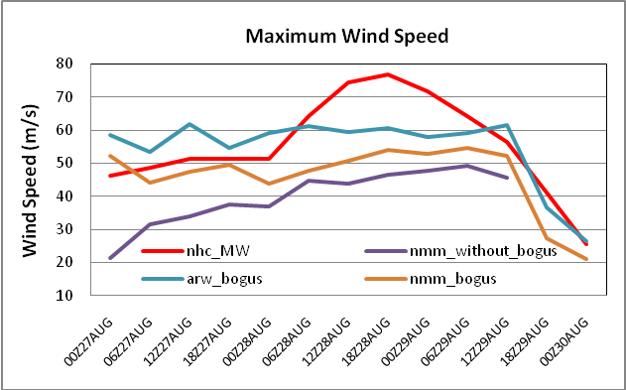
Intercomparison of two WRF dynamical cores

Slide 12
NMM
ARW

Slide 13
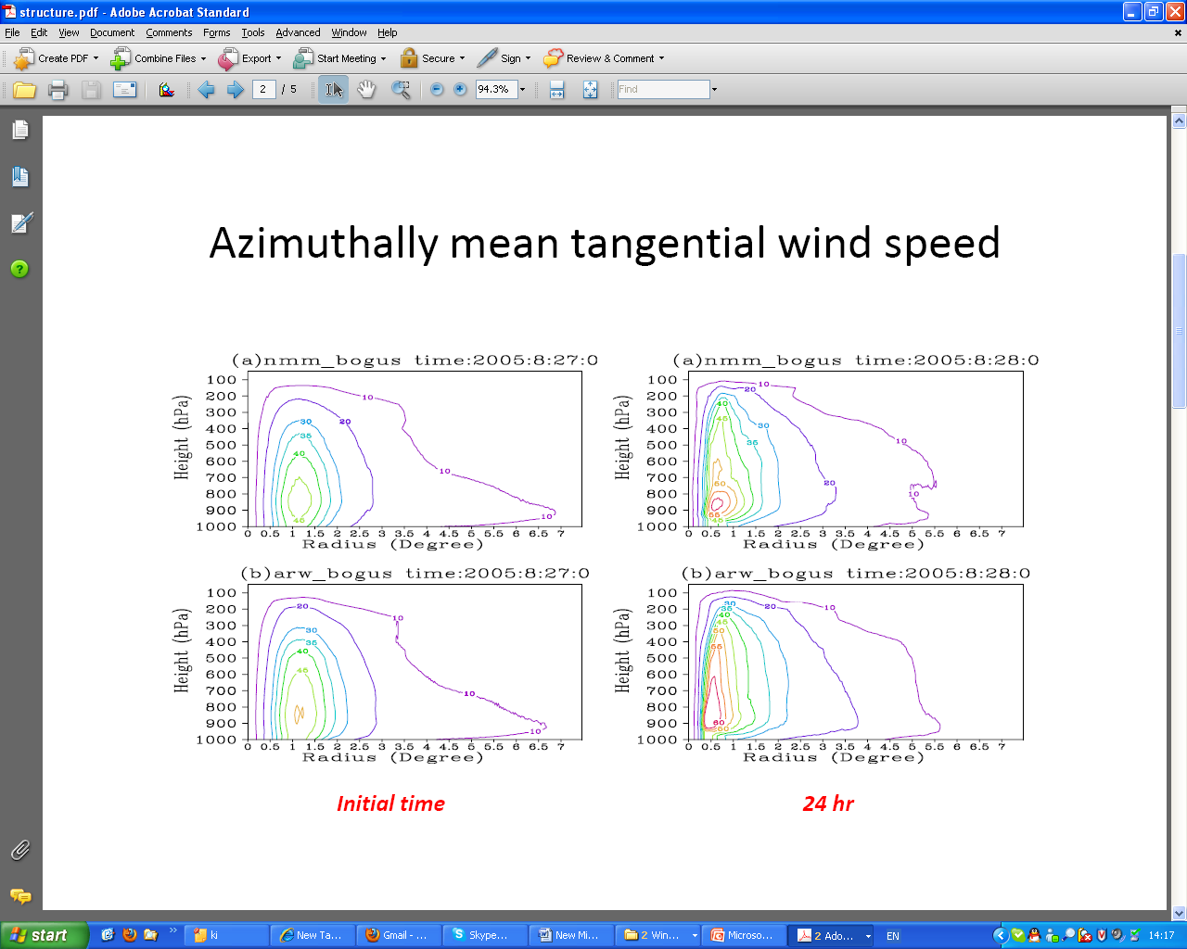
Intercomparison of two WRF dynamical cores

Slide 14
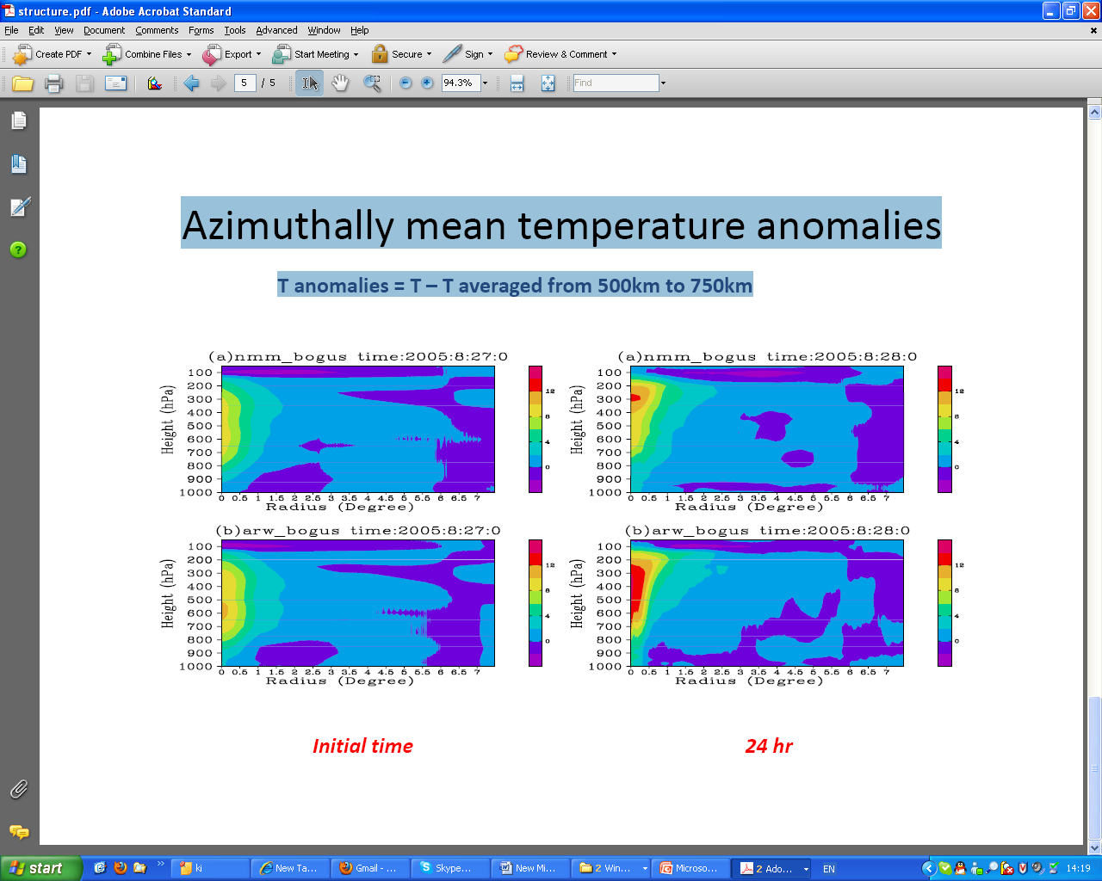

Slide 15
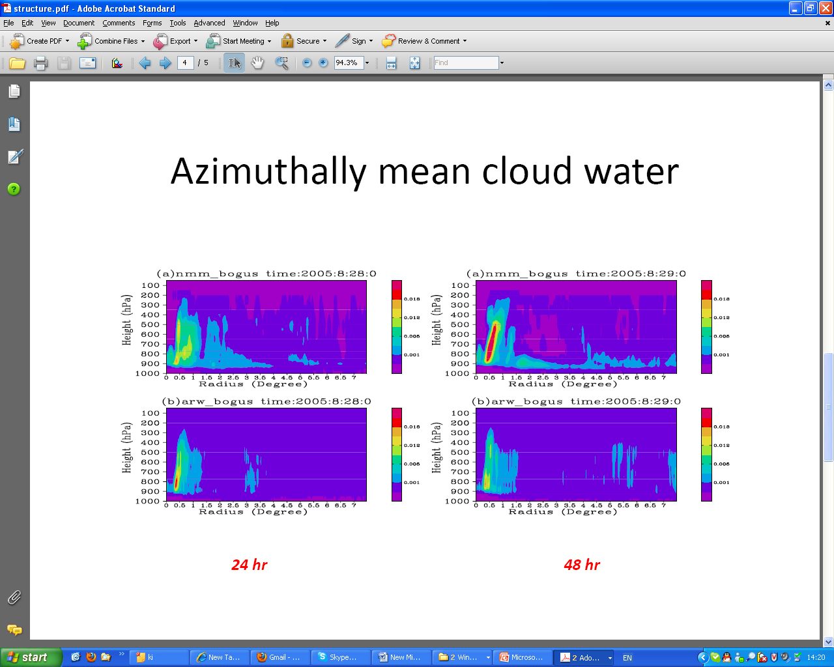
Intercomparison of two WRF dynamical cores
Azimuthal mean diabatic heating

Slide 16
Sensitivity to initial radial wind profile

Slide 18
Summary
Cloud microphysics scheme in HWRF seems not to cause the size increase in the prediction;
Cumulus parameterization is a candidate;
Initial structure of the model vortex is likely the major contributor to the rapid size increase;
Dynamical core affects the cloud microphysics and heating distribution and thus the vertical structure and intensity of the storm;
Evaluation will be extended to the new CP and new initialization scheme in HWRF model.

